Slide 1
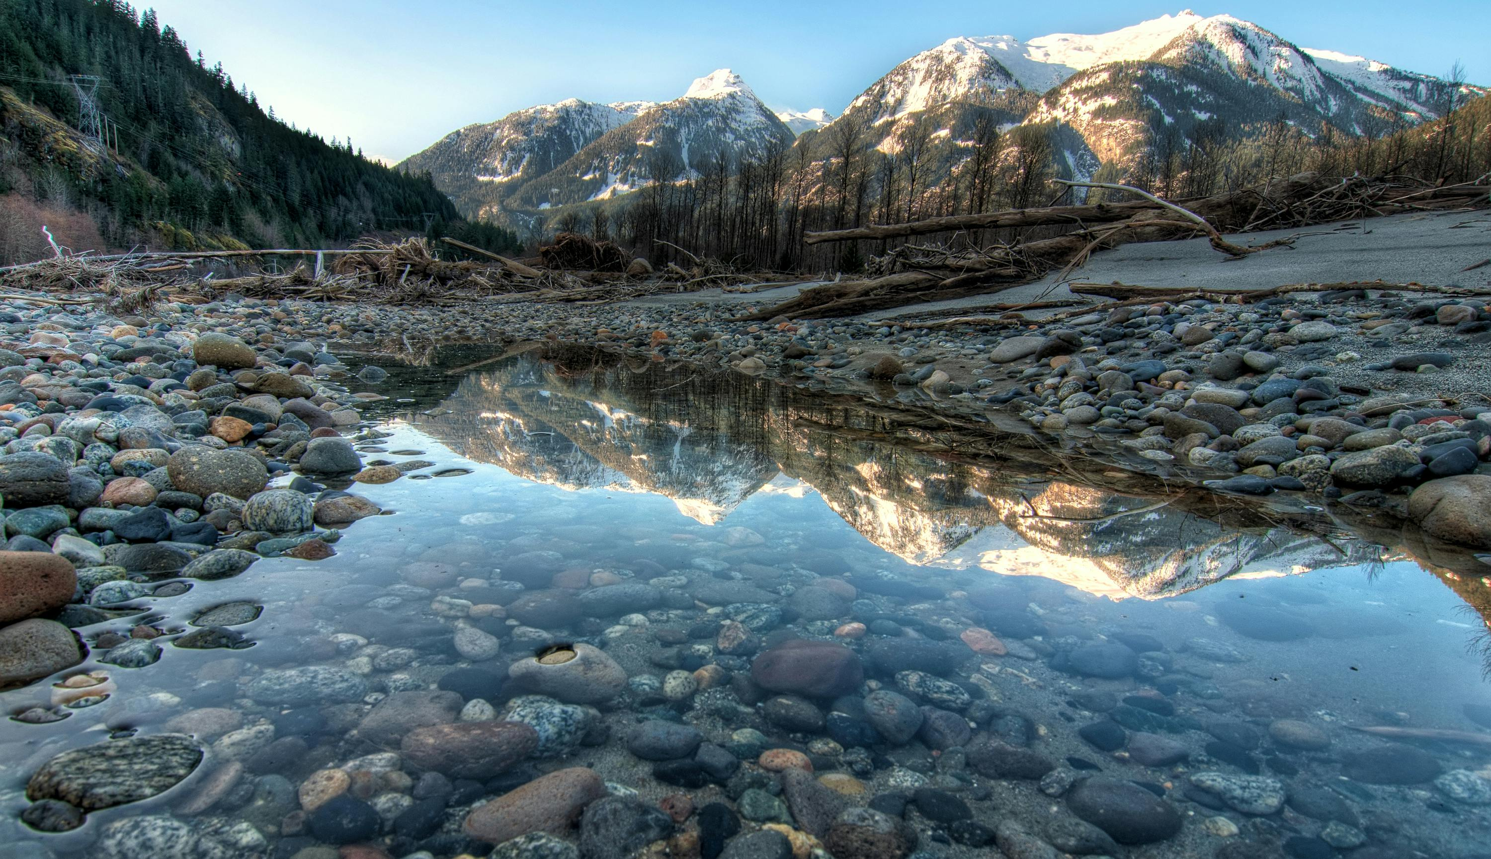
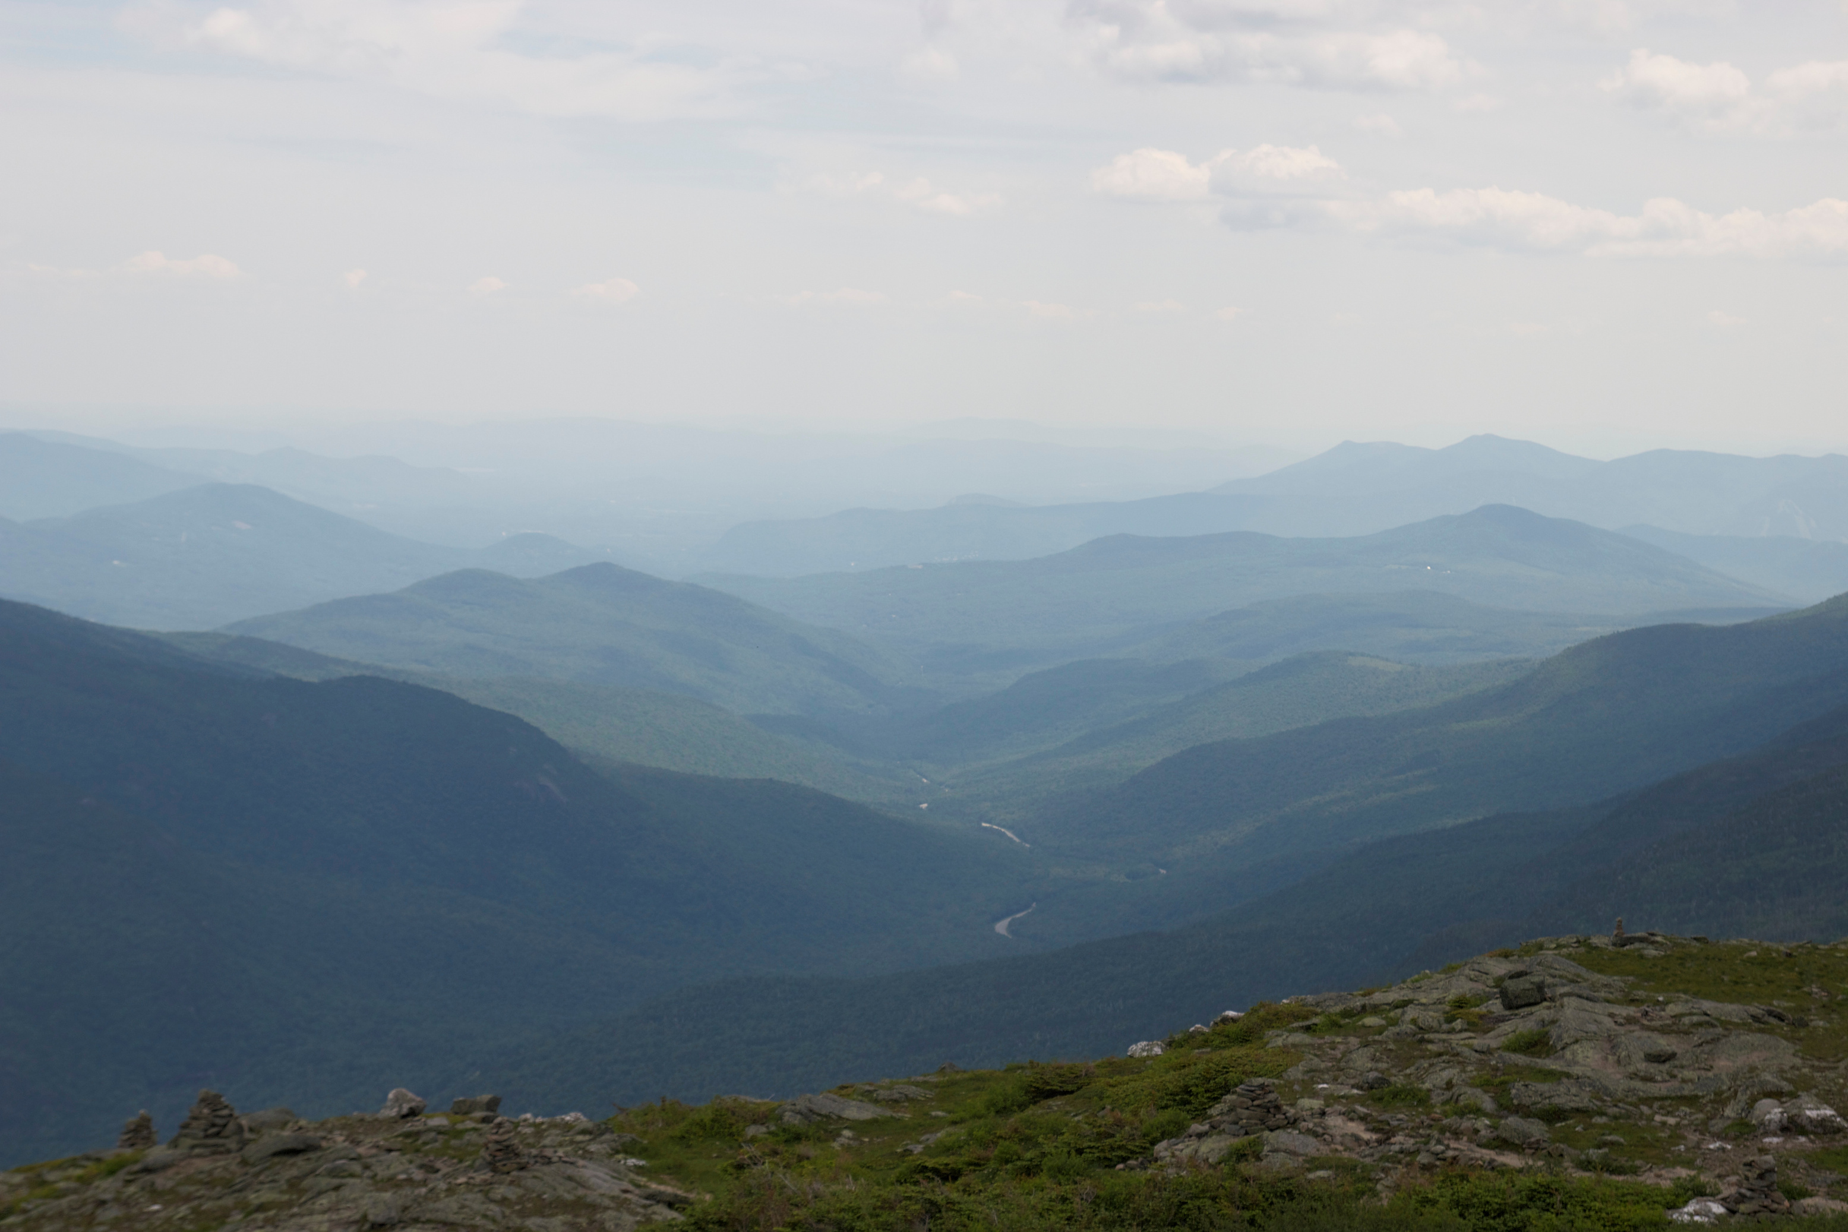
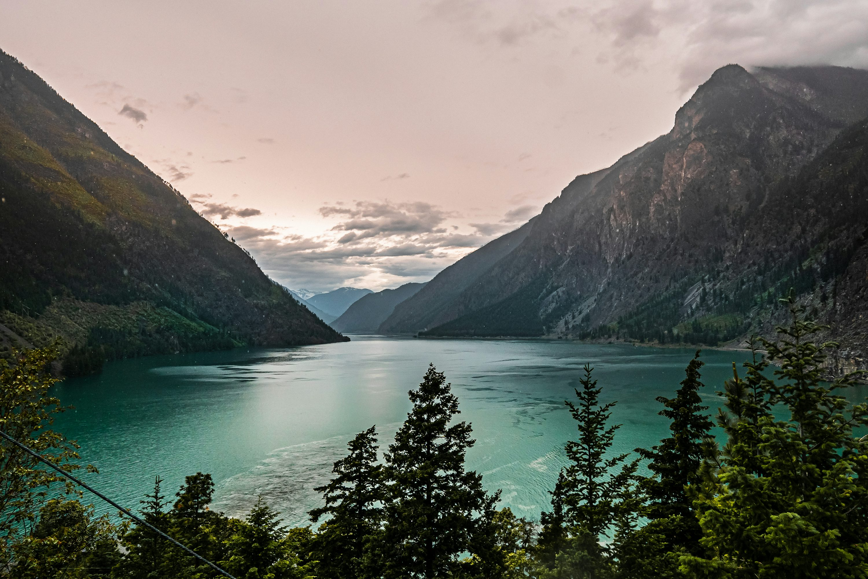
Exploring
The Human Impact
ON WILDLIFE IN BC
Jenny Chung, Kiran John, Mingyue Zhao

Slide 2
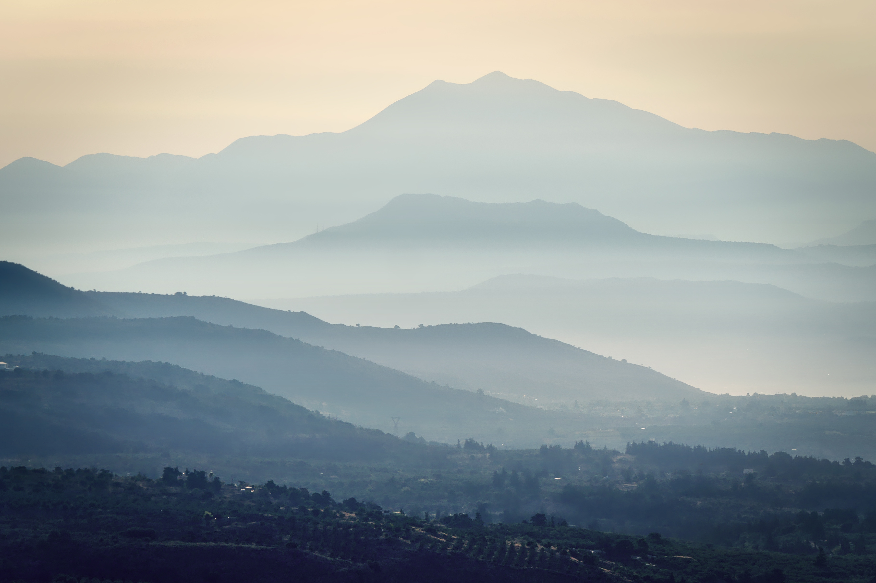
| INTRODUCTION
TABLE OF
| METHODS
CONTENTS
| RESULTS
| DISCUSSION

Slide 3
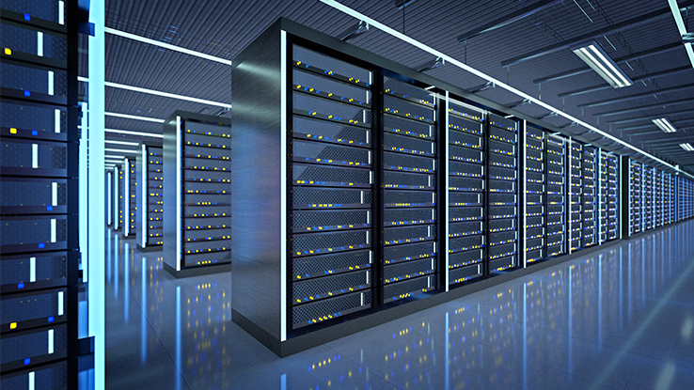
INTRODUCTION
THE DATA ECONOMY OF BC
Data centers have become an integral part of the growing technological world, acting as the hubs for data processing, transmission, and storage There are currently 39 data centers exist in British Columbia alone, with demand pushing for the development of new facilities.
However, we face a critical roadblock: the fact that data centers require significant space and resources.

Slide 4
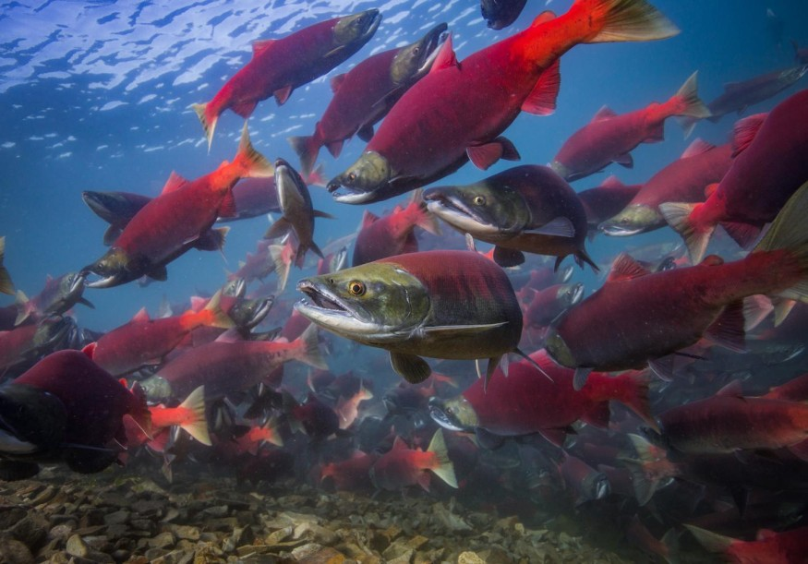
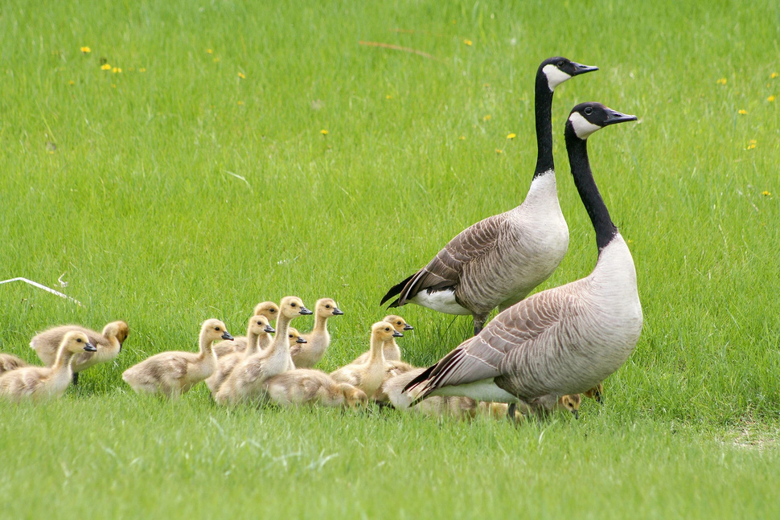
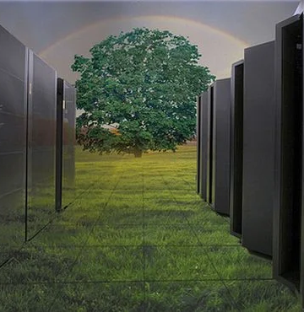
THE PROBLEM
THE GOAL
There is little to no research on the impacts of data centers on the environment, specifically when related to if and how they can affect various living organisms. We want to identify if data centers have some relationship with the spatial distributions of our chosen species.
Using various spatial statistical techniques, we will examine how Salmon and Canada Goose distributions have shifted and relate to environmental factors in the areas of British Columbia where most data centers have been built. Most of our analysis will be conducted in 2024.
THE SPECIES
Data centers consume significant amounts of water and energy and can alter local ecosystems, so we chose species that are especially sensitive to these environmental changes. First, we selected Salmon, a widespread fish native to British Columbia, and the Canada Goose, which inhabits areas along waterways.

Slide 5
THE PROBLEM
THE GOAL
There is little to no research on the impacts of data centers on the environment, specifically when related to if and how they can affect various living organisms. We want to identify if data centers have some relationship with the spatial distributions of our chosen species.
Using various spatial statistical techniques, we will examine how Salmon and Canada Goose distributions have shifted and relate to environmental factors in the areas of British Columbia where most data centers have been built. Most of our analysis will be conducted in 2024.
THE SPECIES
Data centers consume significant amounts of water and energy and can alter local ecosystems, so we chose species that are especially sensitive to these environmental changes. First, we selected Salmon, a widespread fish native to British Columbia, and the Canada Goose, which inhabits areas along waterways.

Slide 6
THE PROBLEM
THE GOAL
There is little to no research on the impacts of data centers on the environment, specifically when related to if and how they can affect various living organisms. We want to identify if data centers have some relationship with the spatial distributions of our chosen species.
Using various spatial statistical techniques, we will examine how Salmon and Canada Goose distributions have shifted and relate to environmental factors in the areas of British Columbia where most data centers have been built. Most of our analysis will be conducted in 2024.
THE SPECIES
Data centers consume significant amounts of water and energy and can alter local ecosystems, so we chose species that are especially sensitive to these environmental changes. First, we selected Salmon, a widespread fish native to British Columbia, and the Canada Goose, which inhabits areas along waterways.

Slide 7




METHODS
COLLECTION
EDA
PROCESSING
ANALYSIS
Retrieval from several different datasets
First Moment Statistics, Preliminary Insights
Transformation, Cleaning, Conversion
Modelling, Evaluation, Predictions

Slide 8
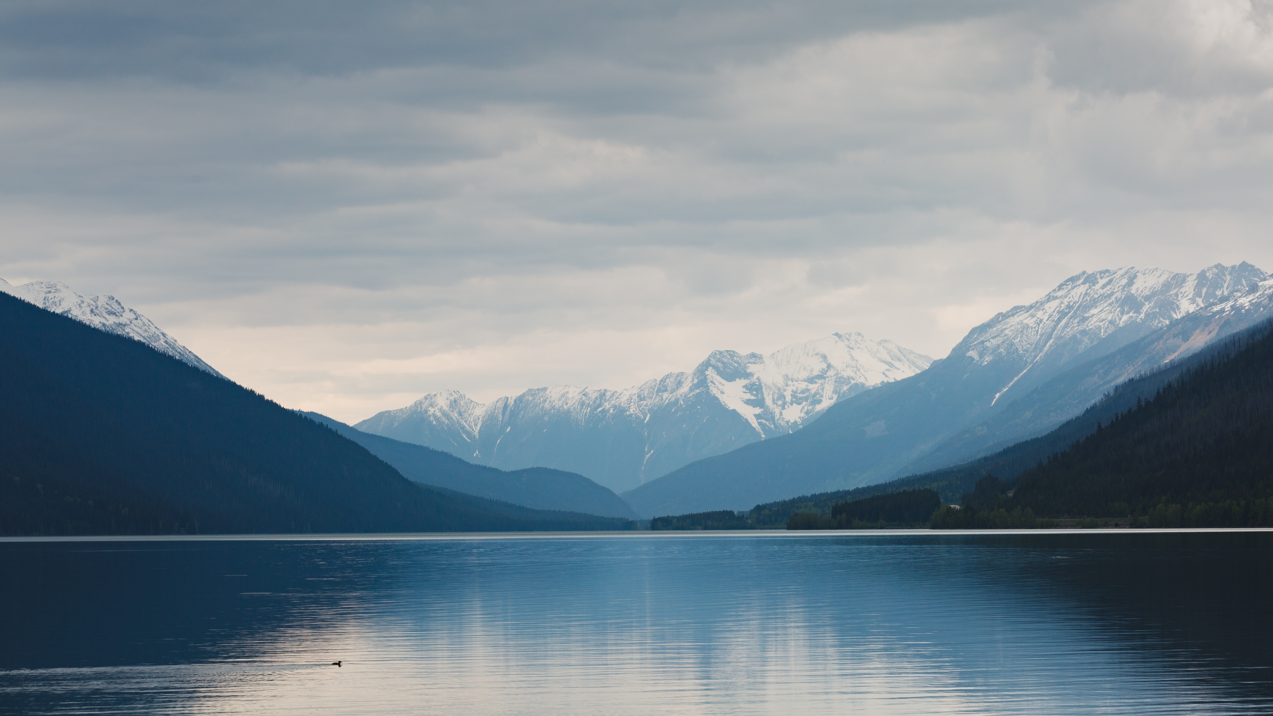
| British Columbia Map
| British Columbia Covariates
| Salmon/Goose Locations
| Data Center Locations
DATA
COLLECTION

Slide 9
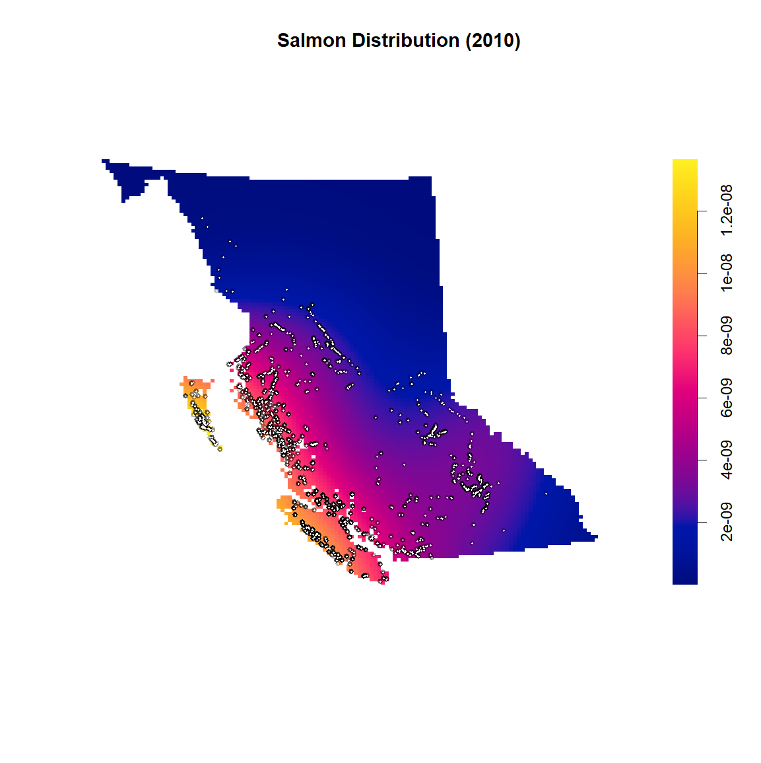
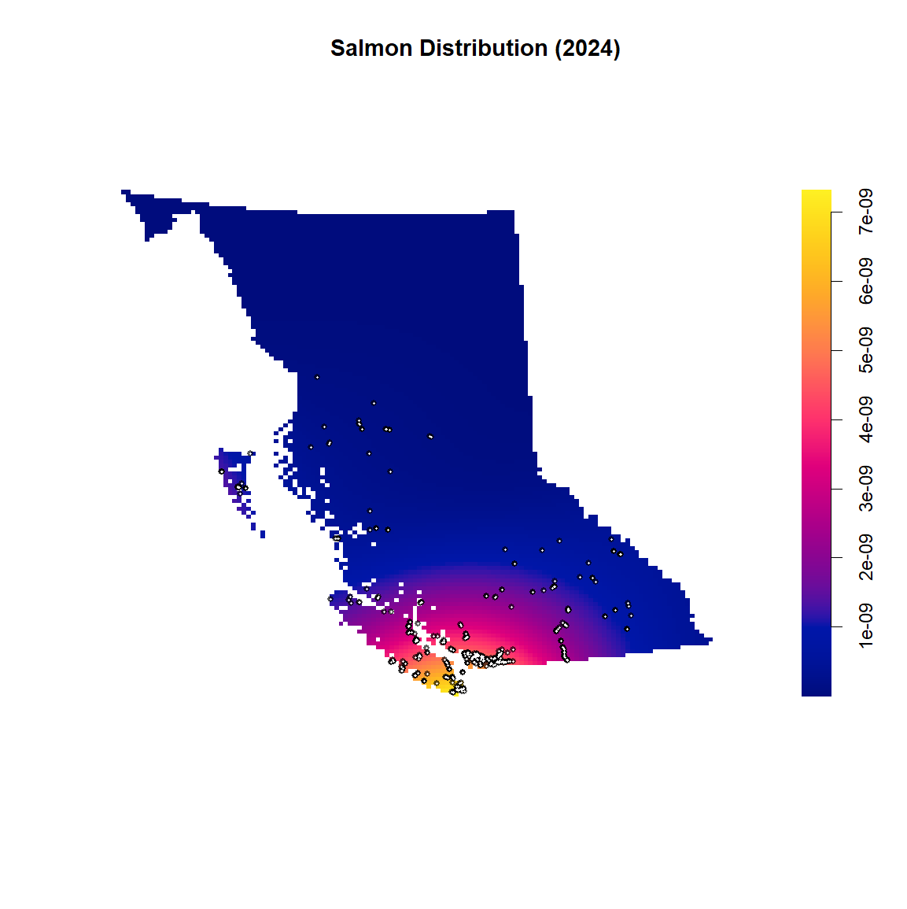
EDA
SALMON
Distribution of Five Salmon Species in BC: 2010 vs. 2024
2010 Observations (n = 2,730)
2024 Observations (n = 703)

Slide 10
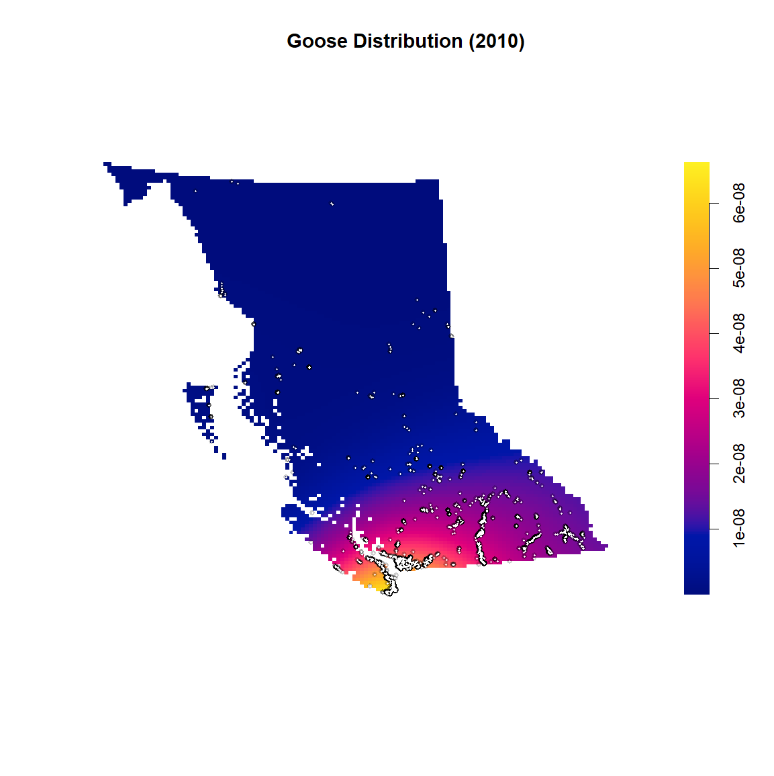
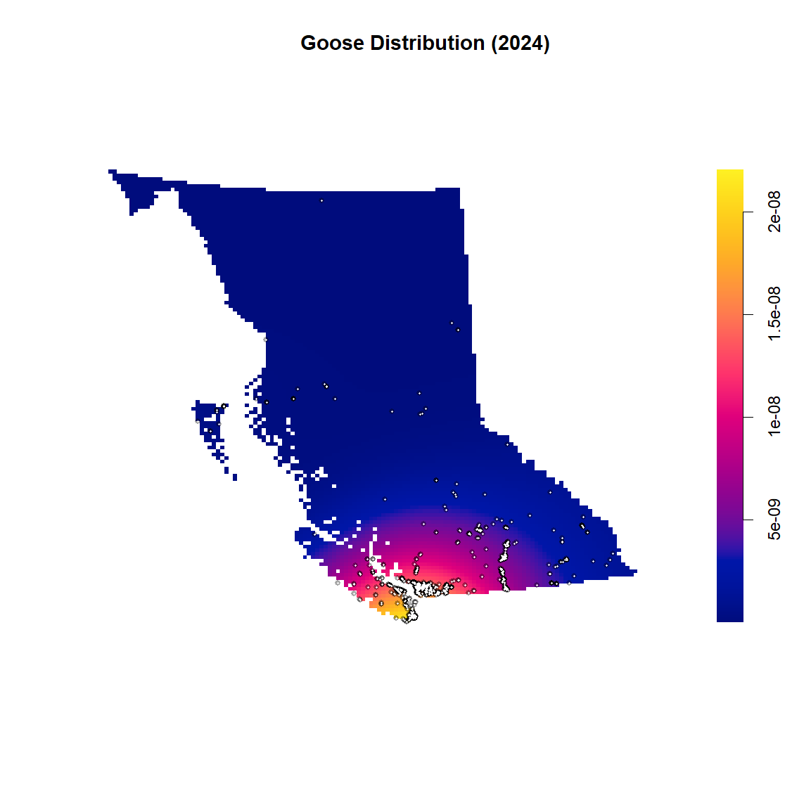
EDA
Goose
Distribution of Canadian Goose in BC: 2010 vs. 2024
2010 Observations (n = 6,906)
2024 Observations (n = 1,798)

Slide 11
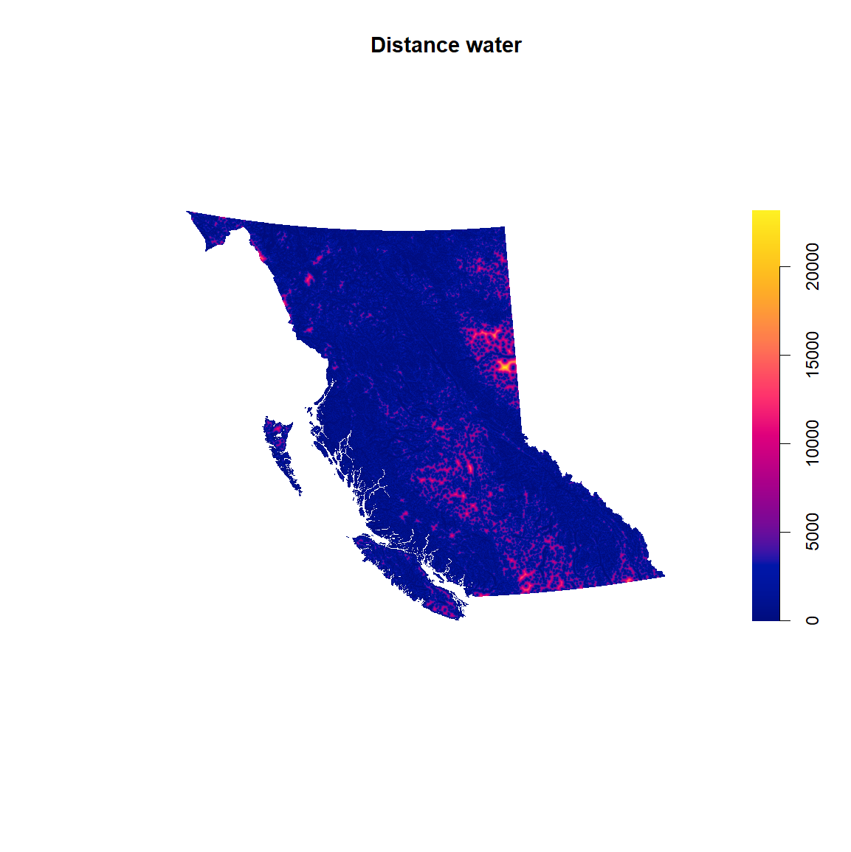
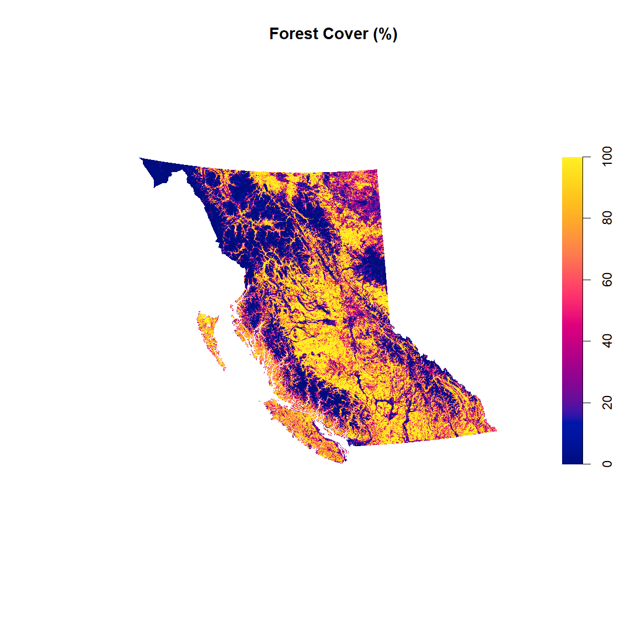
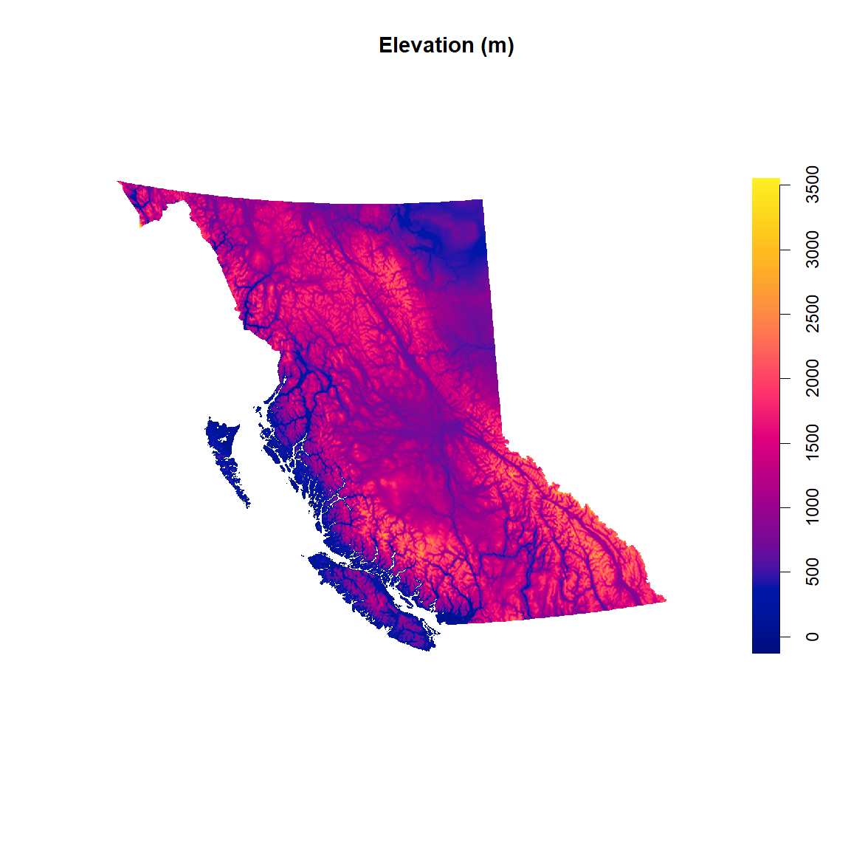
EDA
Covariates
Distance to Water (m)
Forest Cover (%)
Elevation (m)
NA values only present in the elevation data, but the data in general is in a tidy and useable format

Slide 12
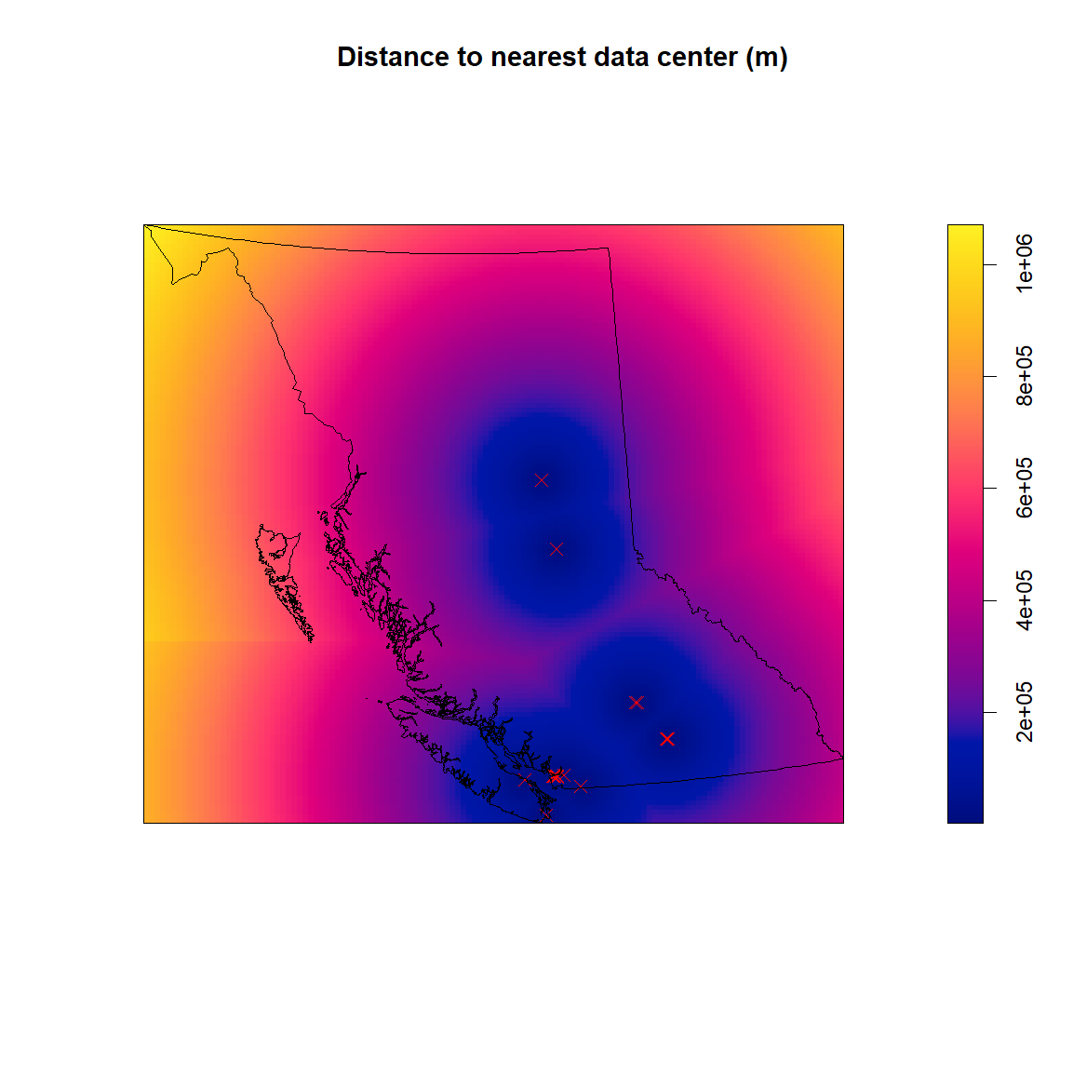
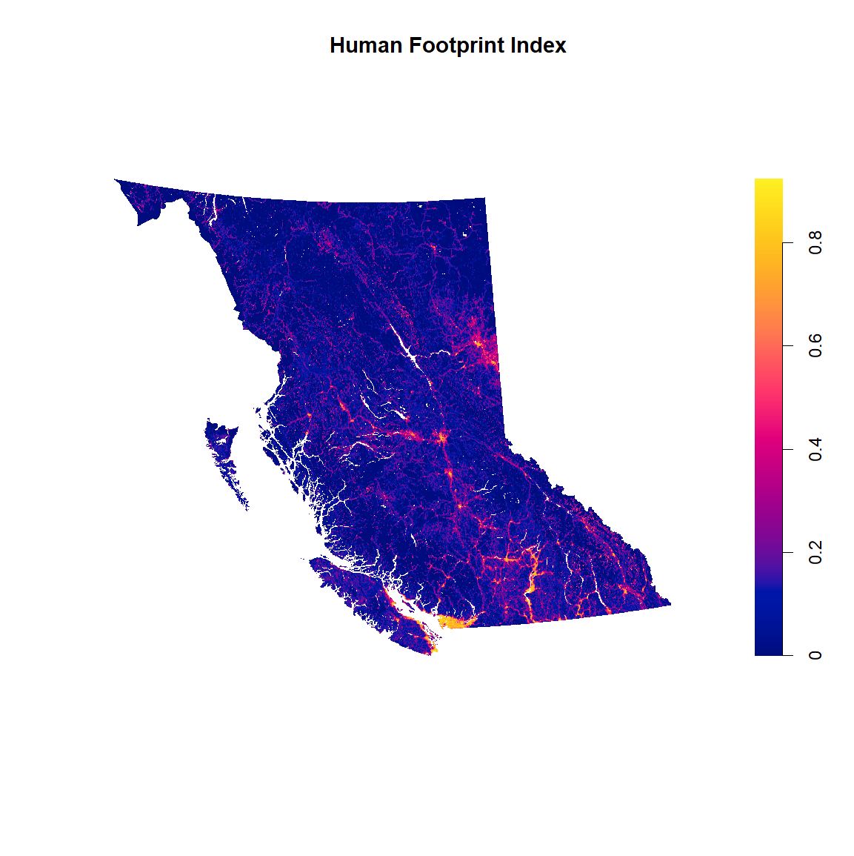
EDA
More Covariates
Distance to Nearest Data Center (m)
Human Footprint Index (HFI)
There are 39 data centers in BC, most of which are located near bodies of water
The HFI data has missing values, meaning interpolation may be required

Slide 13
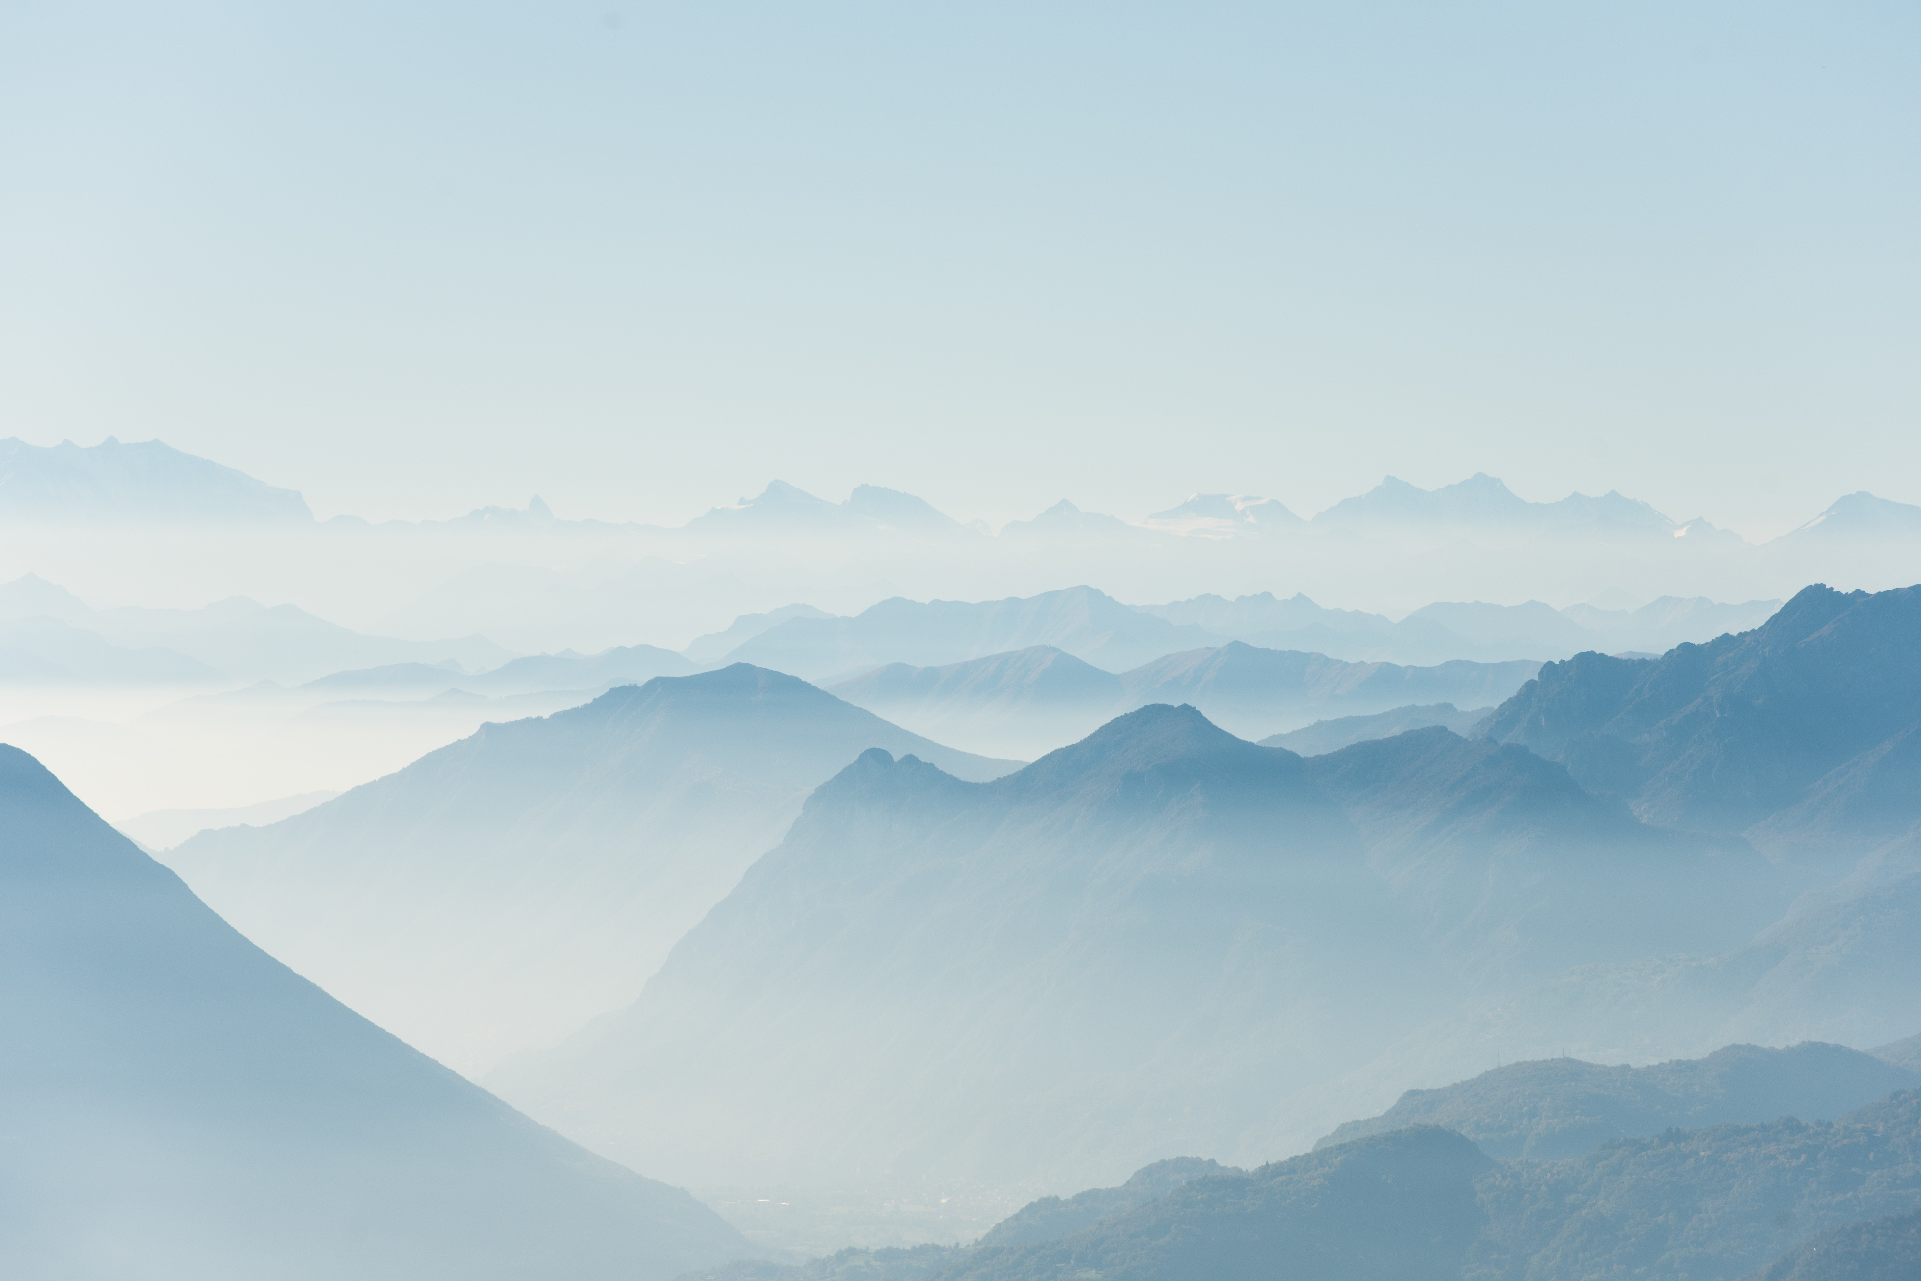
SPECIES COORDINATE ADJUSTMENT
To align with the covariate window, we transformed the coordinate reference system from WGS84 to the target projection
INTERPOLATION OF HFI AND ELEVATION
Because both the HFI and elevation datasets contained missing values, we imputed those gaps using each dataset’s median value
FEATURE
ENGINEERING

Slide 14
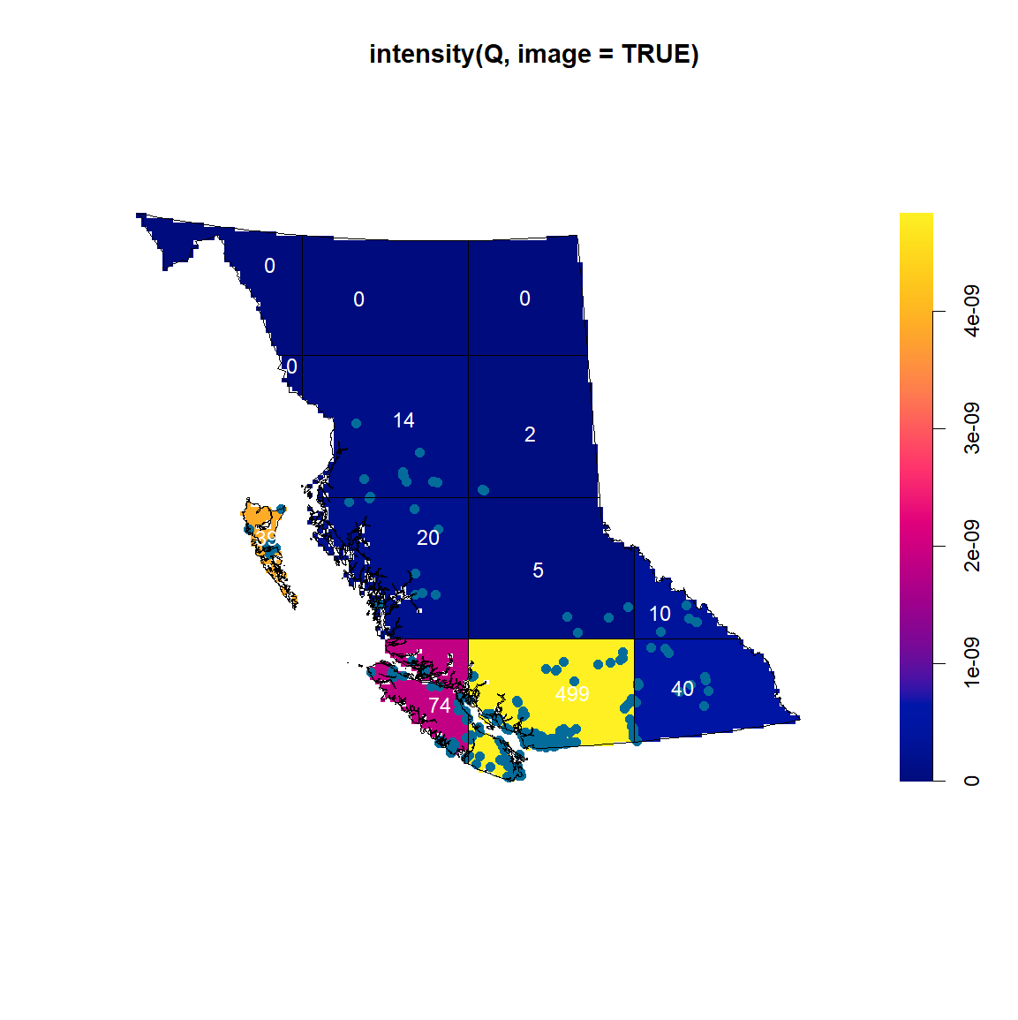
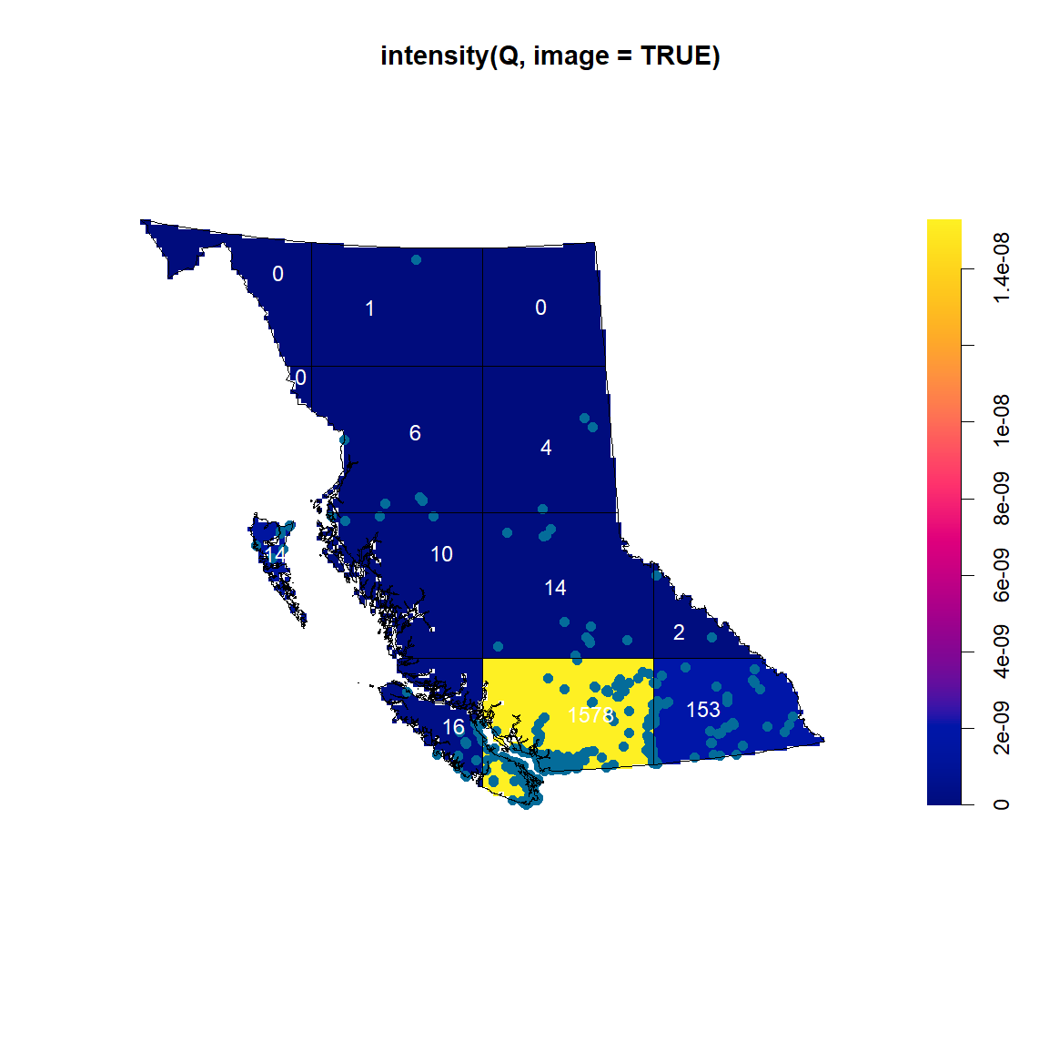
Analysis
Quadrat Test
Salmon
Goose
The p-values of both quadrat tests are below 0.05, suggesting a significant deviation from homogeneity

Slide 15
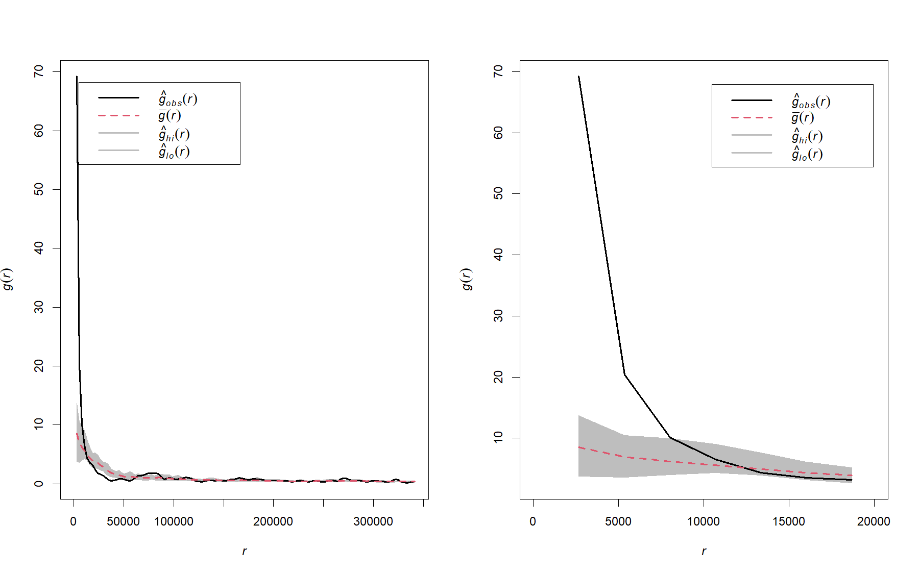
Analysis
Pair Correlation Function (PCF)
Salmon PCF Plots
There appears to be more salmon than expected by random chance between 0 and 7000 metres

Slide 16
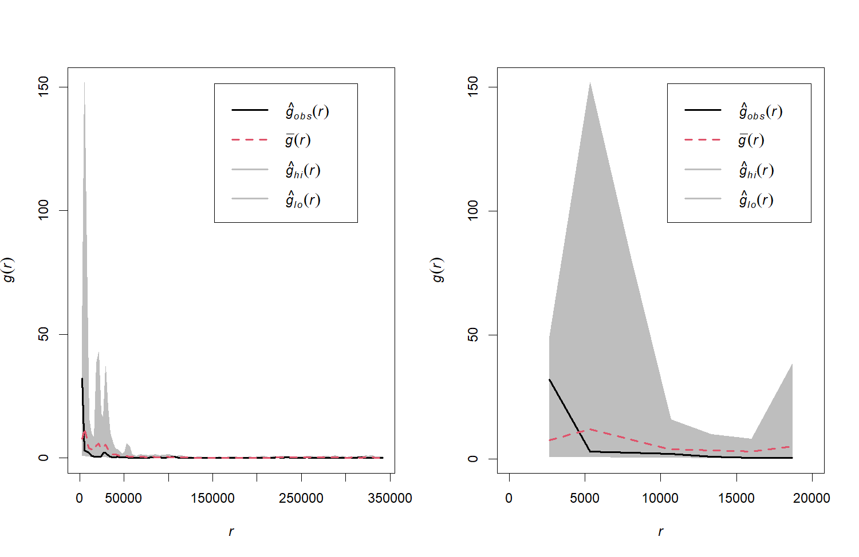
Analysis
Pair Correlation Function (PCF)
Goose PCF Plots
Goose locations are clustered at small scales (within 5km), but overall, there’s no clear large-scale clustering

Slide 17
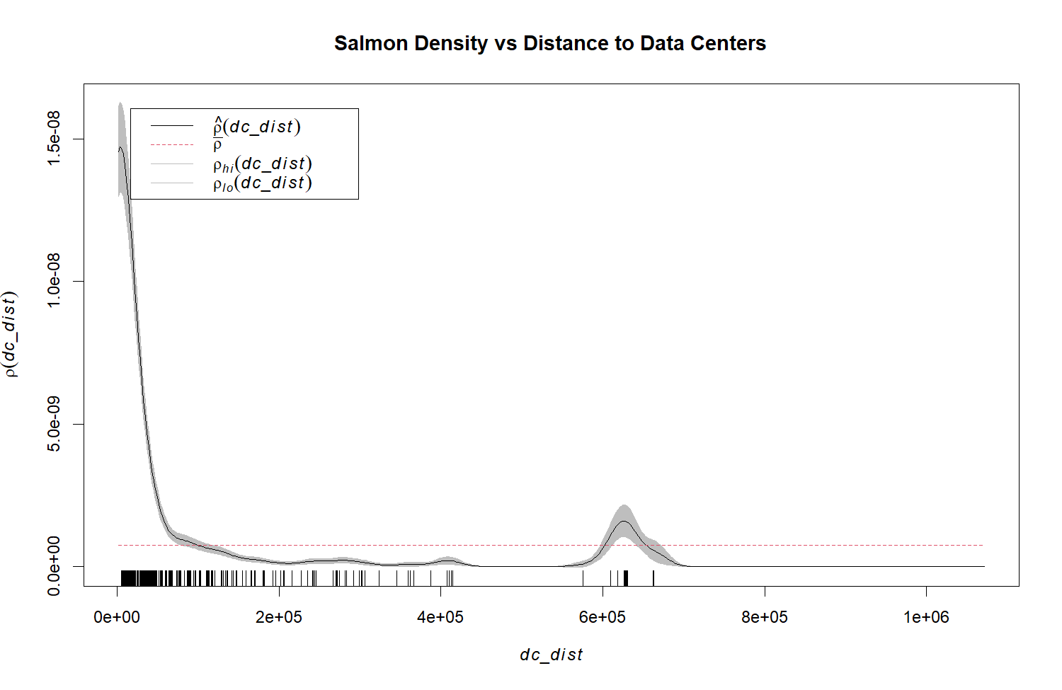
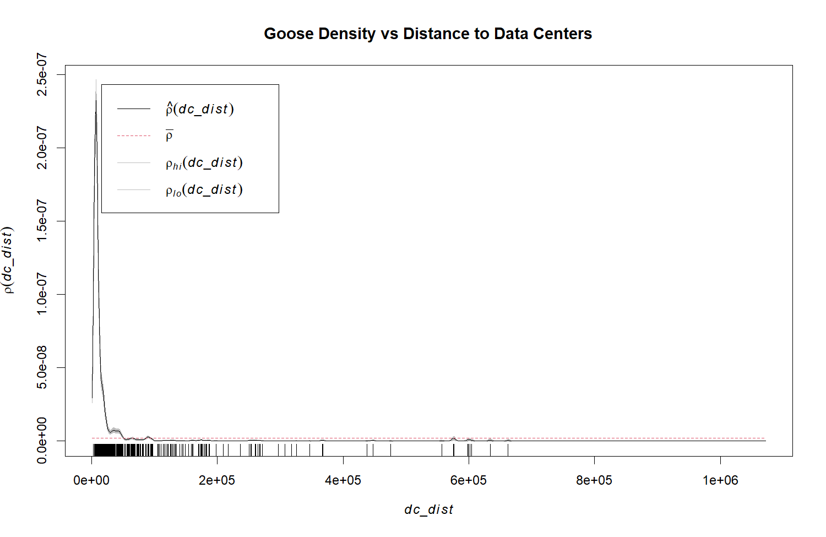
Analysis
Covariate Relationships
Exception
Stronger intensity at low distance values for both species

Slide 18
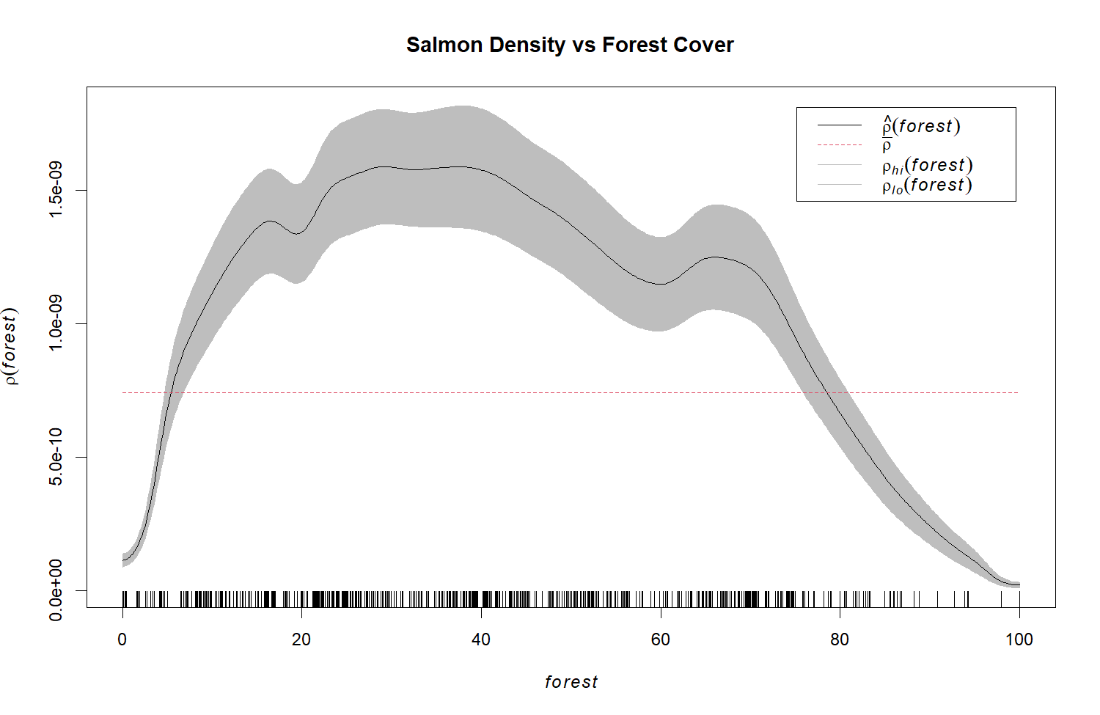
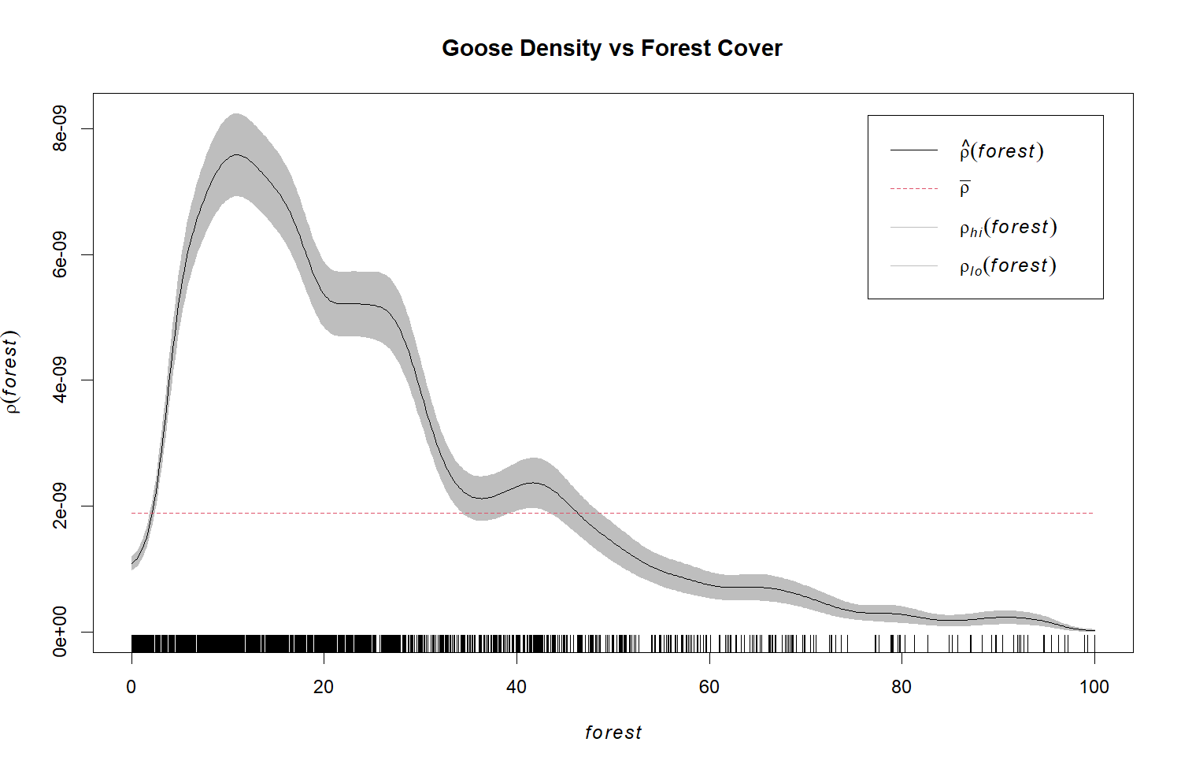
Analysis
Covariate Relationships
Quadratic relationships with varying intensity depending on species

Slide 19
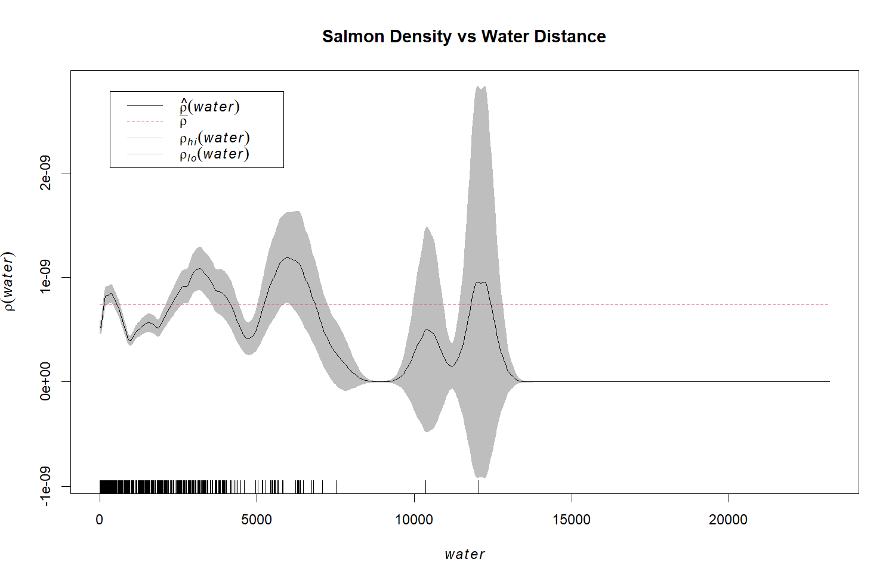
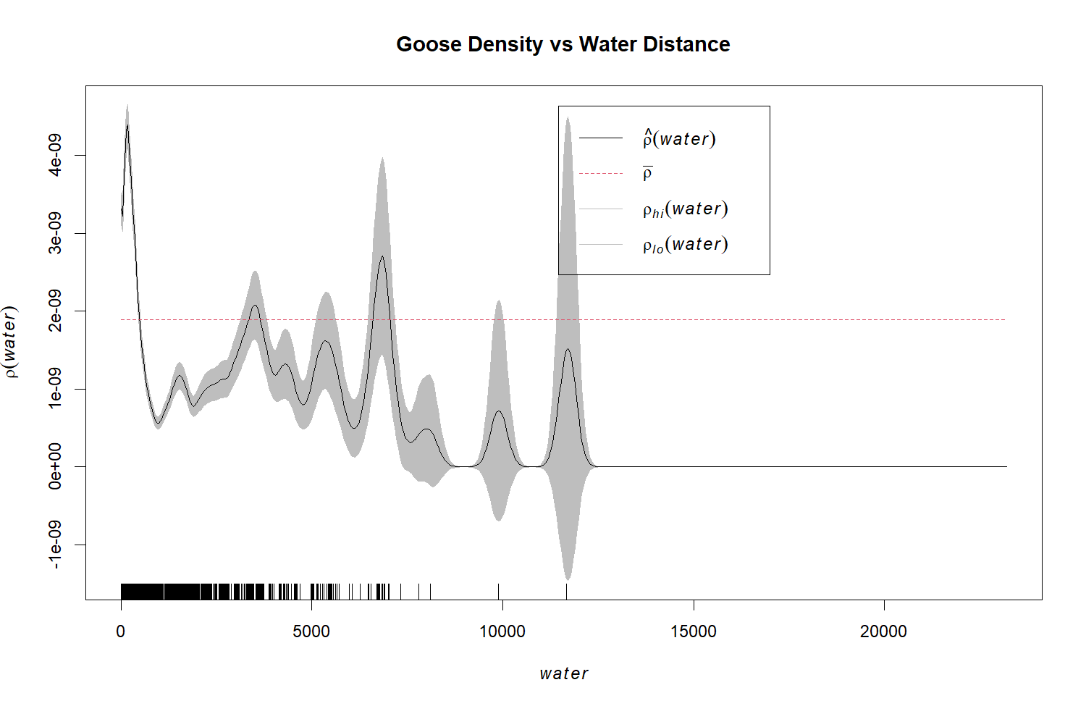
Analysis
Covariate Relationships
Complex/unclear relationships with water distance

Slide 20
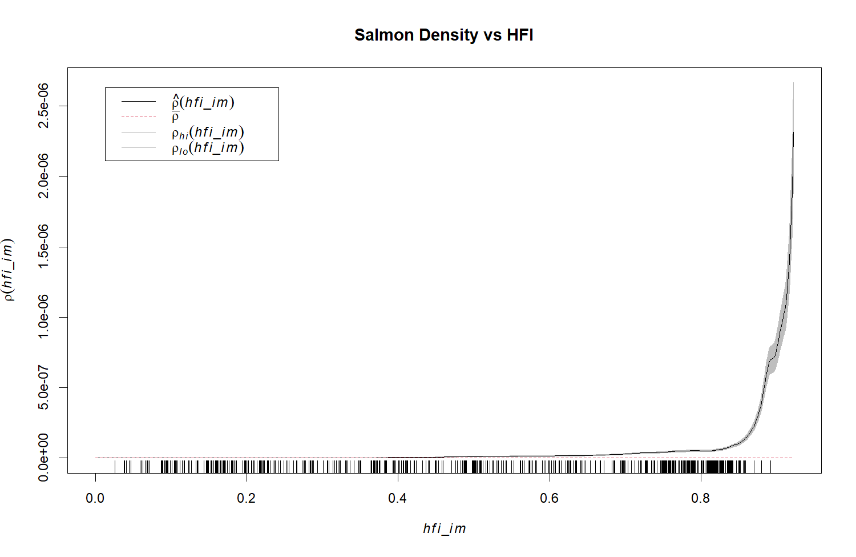
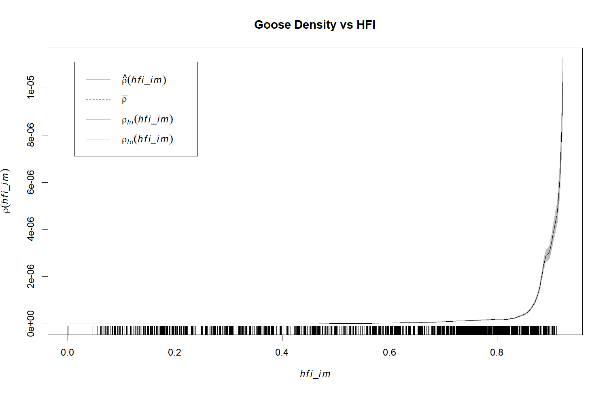
Analysis
Covariate Relationships
Higher HFI points toward a higher intensity of species

Slide 21
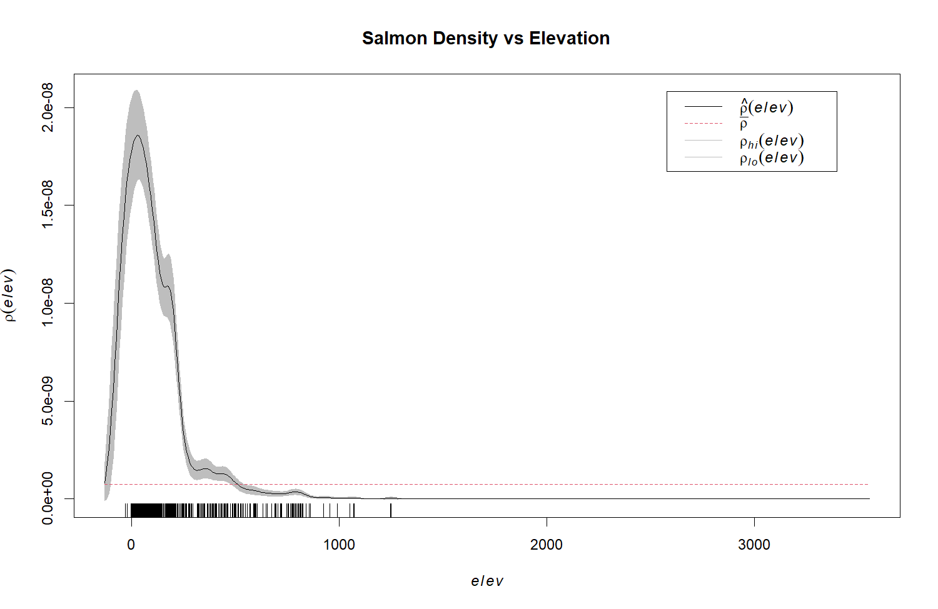
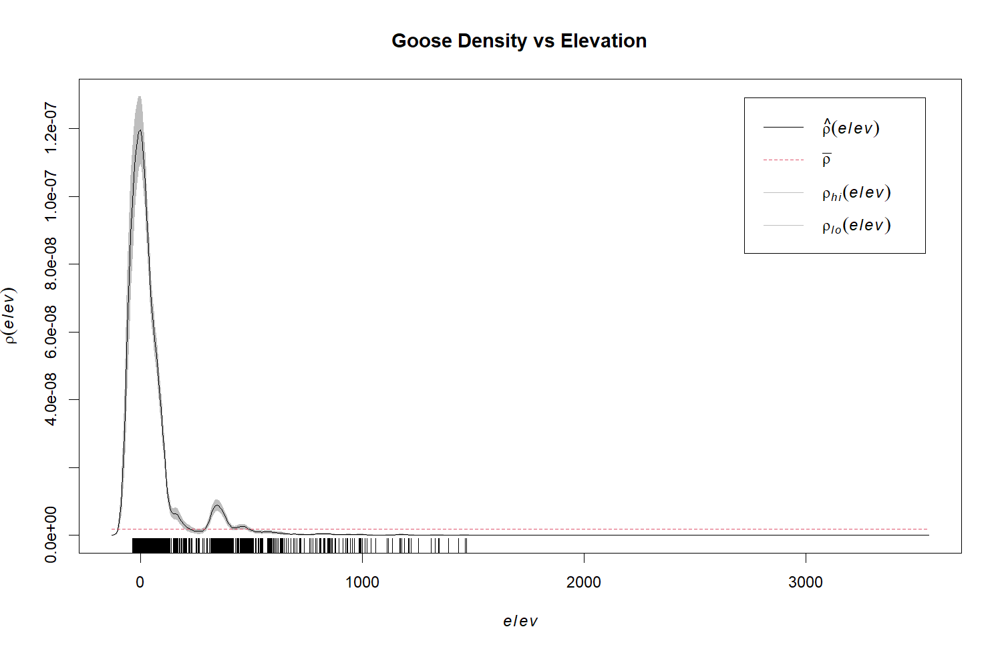
Analysis
Covariate Relationships
Quadratic relationships at low elevation levels for both species

Slide 22
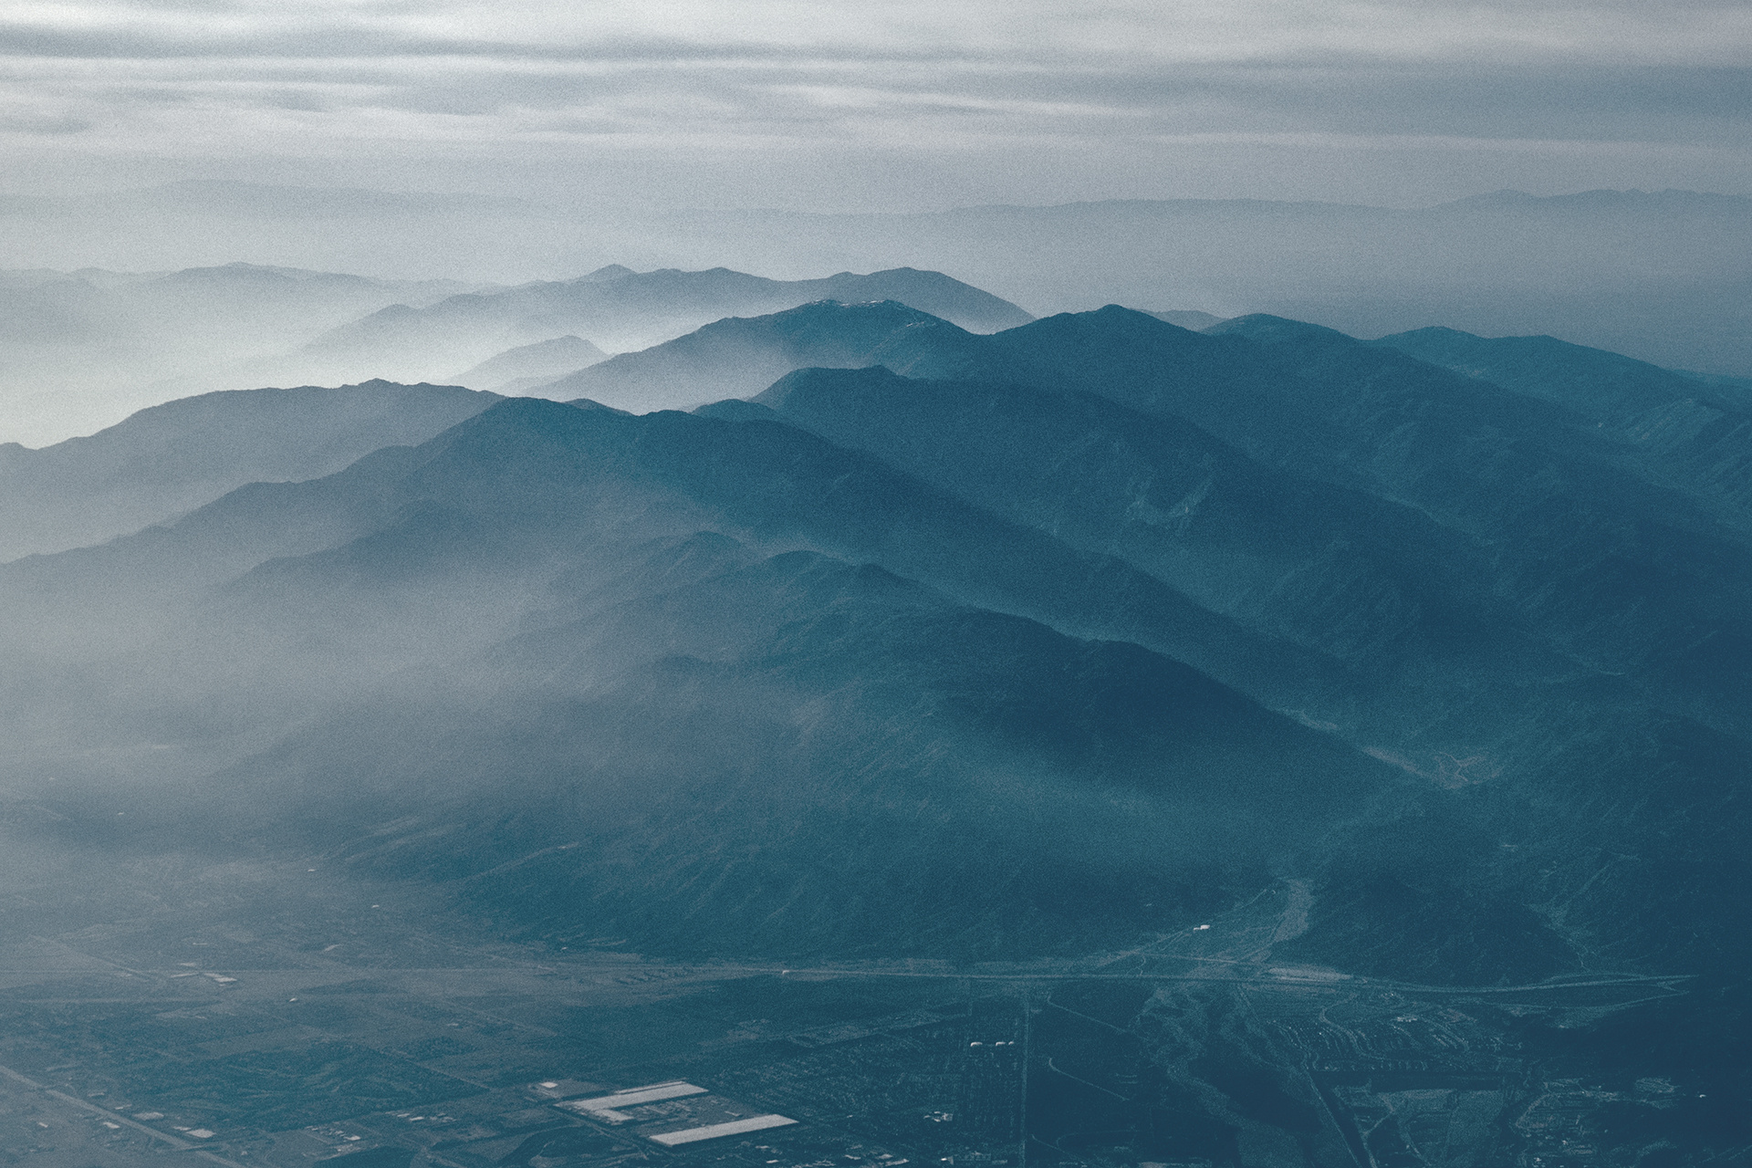
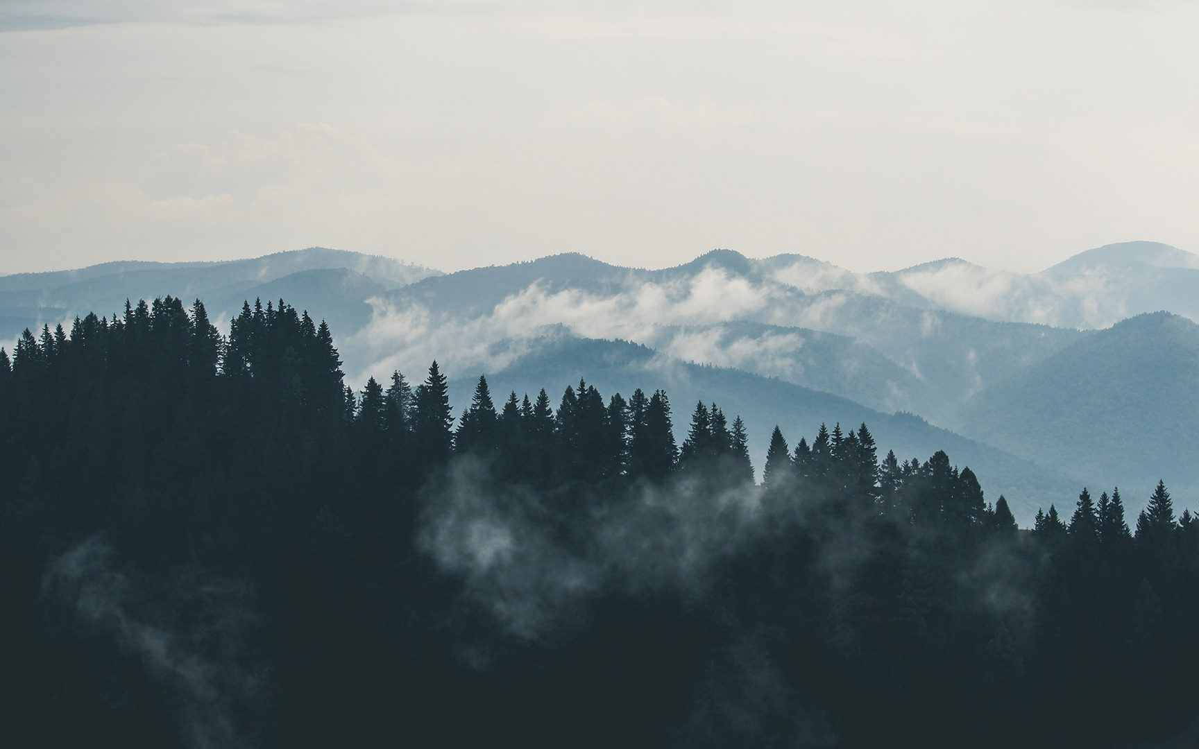
POISSON PROCESS
RESULTS
Using a Poisson process, we can approximate the distributions of our animal species through our various covariates. As we will see, it seems that data centers have an effect when considering their impact on animal distributions throughout the province.

Slide 23
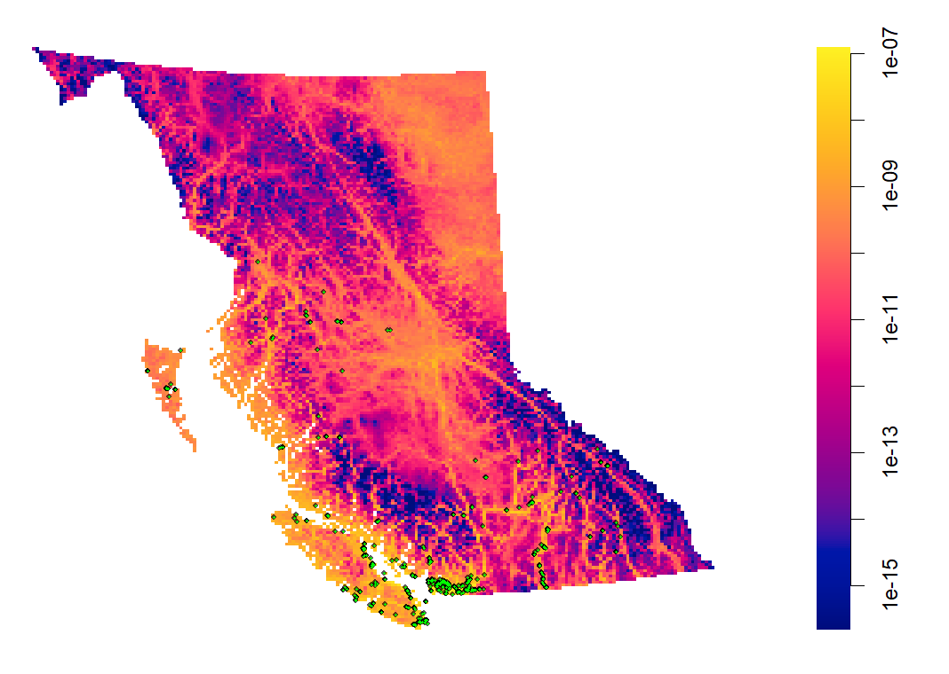
FITTED MODEL:
SALMON
 | Estimate | S.E. | CI95.lo | CI95.hi | Ztest | Zval
(Intercept) | -18.6651 | 0.192486 | -19.0424 | -18.2879 | *** | -96.9686
dc_dist | -5.28E-06 | 3.96E-07 | -6.05E-06 | -4.50E-06 | *** | -13.3123
hfi_im | 2.579698 | 0.192688 | 2.202037 | 2.957359 | *** | 13.38797
elev | -0.00276 | 0.000487 | -0.00372 | -0.00181 | *** | -5.66653
water | -9.60E-05 | 2.35E-05 | -0.00014 | -4.99E-05 | *** | -4.07929
forest | 0.03002 | 0.005167 | 0.019893 | 0.040147 | *** | 5.809988
I(forest^2) | -0.00025 | 5.43E-05 | -0.00036 | -0.00015 | *** | -4.67715
I(elev^2) | -2.19E-06 | 5.90E-07 | -3.34E-06 | -1.03E-06 | *** | -3.70484
Validation
Model Type | AIC
Null | 30965.69
Simple | 26932.78
Full | 26889.84
No Data Center | 27101.68
*lower AIC is better
Fitted point process model with salmon locations overlayed on top of fit

Slide 24
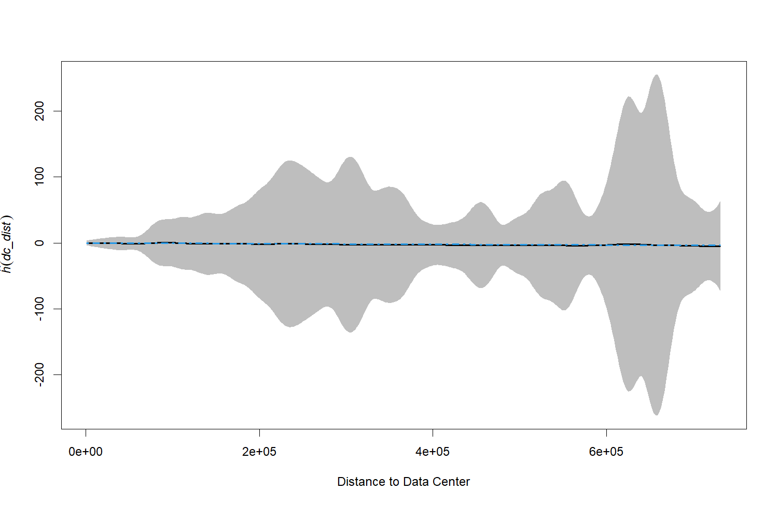
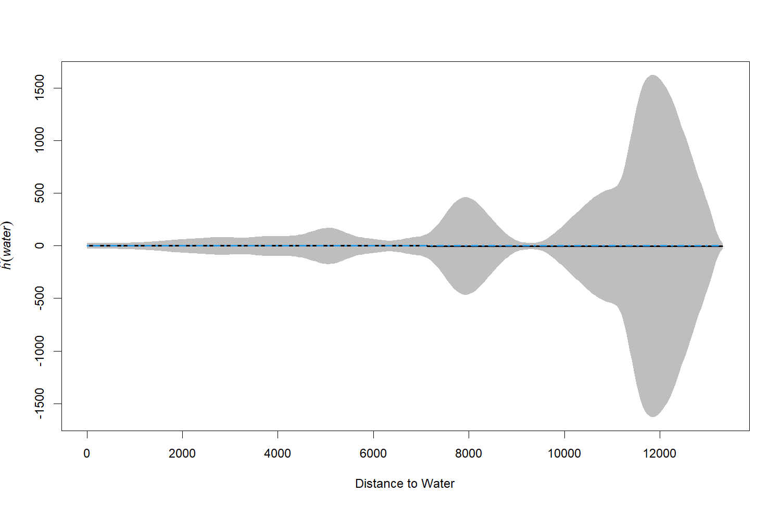
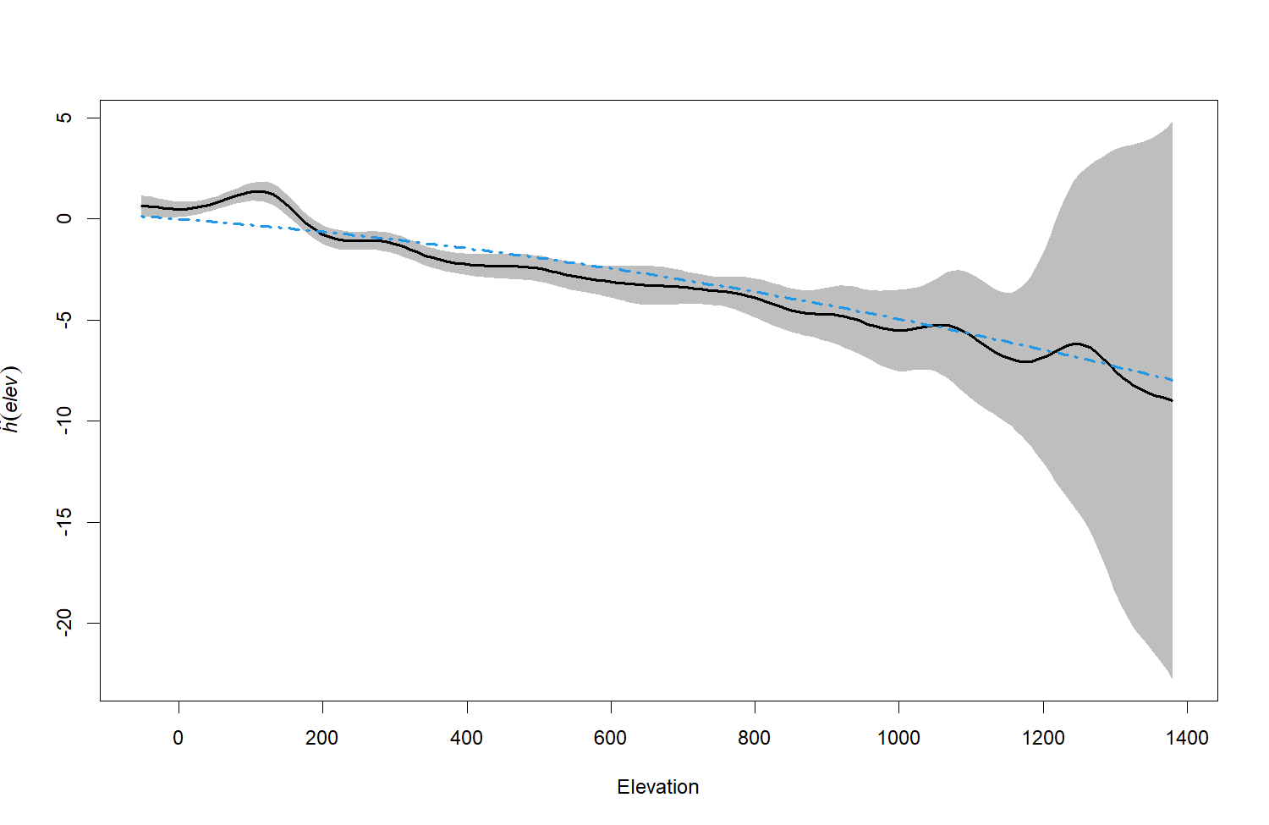
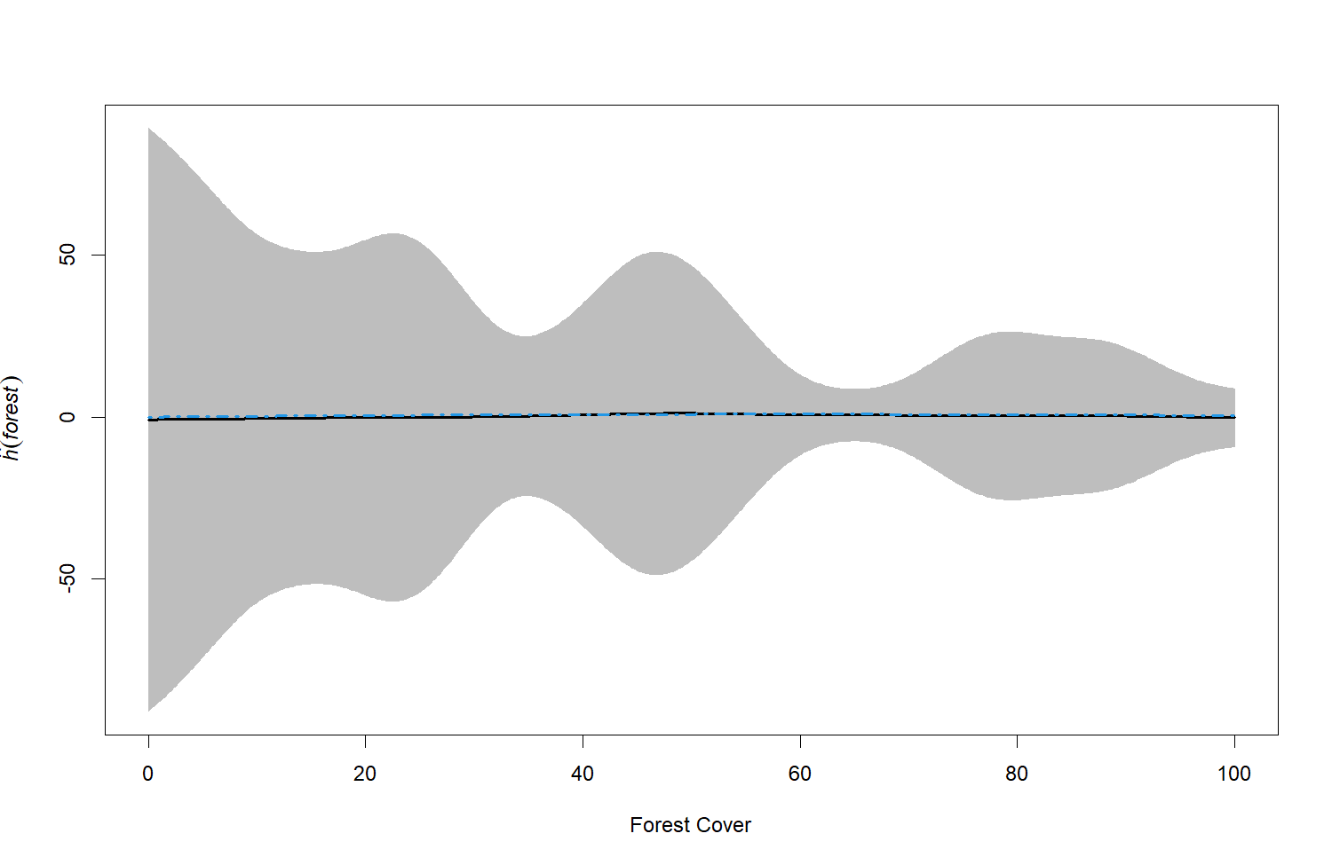
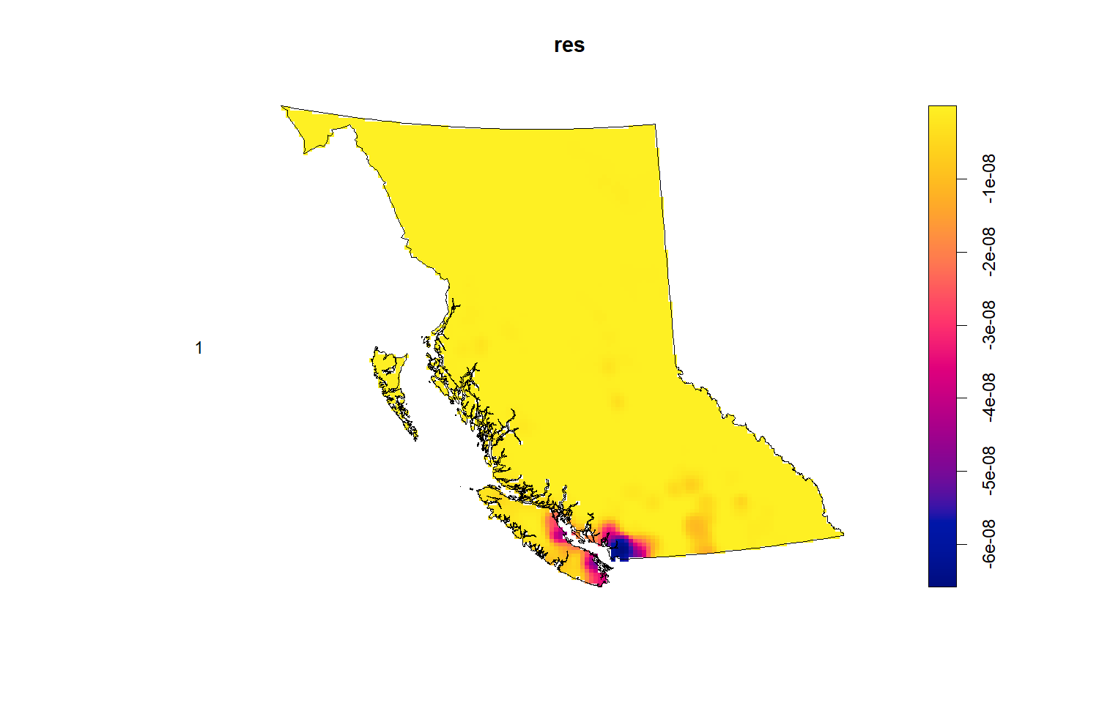
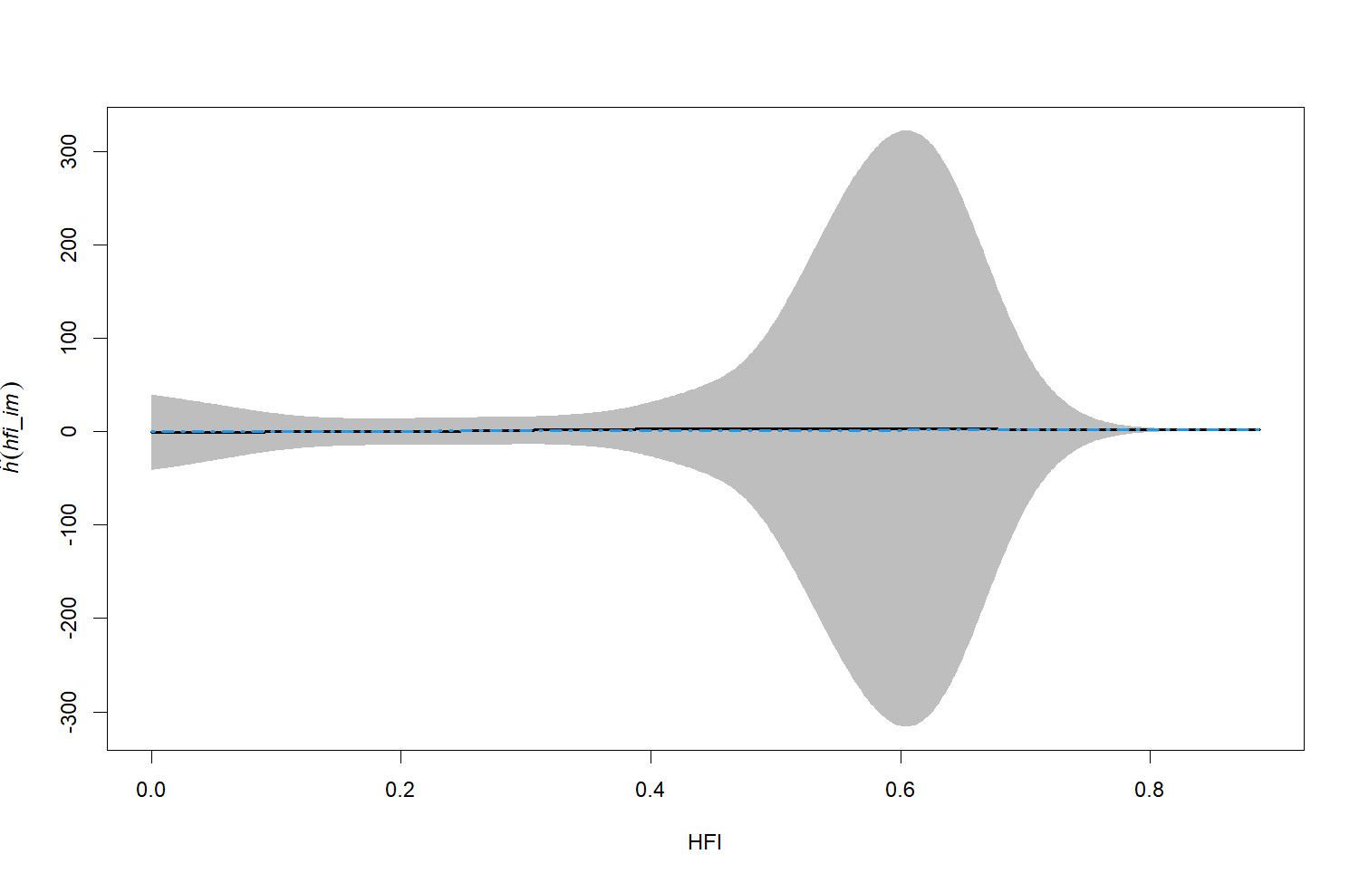
Partial Residual Plots
RESIDUALS:
SALMON
BC Residual Map

Slide 25
Partial Residual Plots
RESIDUALS:
SALMON
BC Residual Map

Slide 26
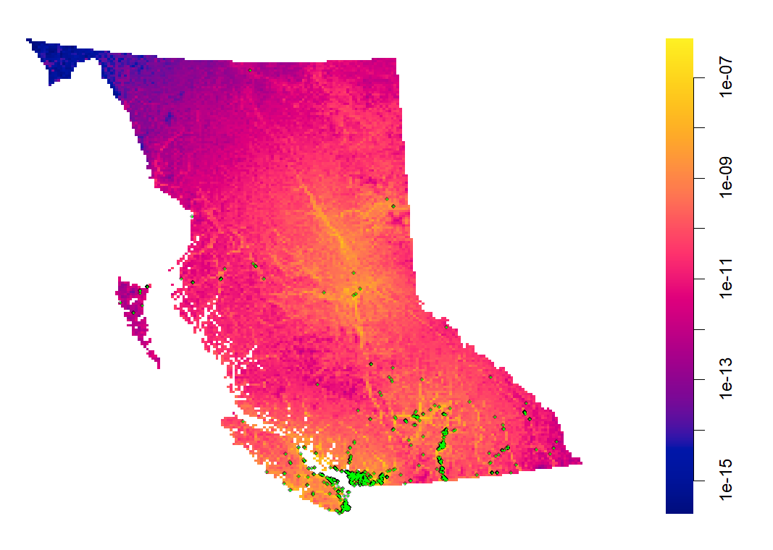
FITTED MODEL:
GOOSE
 | Estimate | S.E. | CI95.lo | CI95.hi | Ztest | Zval
(Intercept) | -15.7542 | 0.098484 | -15.9472 | -15.5612 | *** | -159.967
dc_dist | -1.50E-05 | 6.82E-07 | -1.63E-05 | -1.36E-05 | *** | -21.9487
hfi_im | 2.2903 | 0.113305 | 2.068226 | 2.512373 | *** | 20.2136
elev_im | -0.00437 | 0.000188 | -0.00474 | -0.004 | *** | -23.222
forest | -0.01727 | 0.001301 | -0.01982 | -0.01472 | *** | -13.2724
water | -0.0003 | 1.81E-05 | -0.00033 | -0.00026 | *** | -16.3746
I(elev^2) | 1.11E-06 | 1.41E-07 | 8.39E-07 | 1.39E-06 | *** | 7.926511
Validation
Model Type | AIC
Null | 75818.15
Simple | 61838.94
Full | 61794.79
No Data Center | 63175.76
*lower AIC is better
Fitted point process model with goose locations overlayed on top of fit

Slide 27
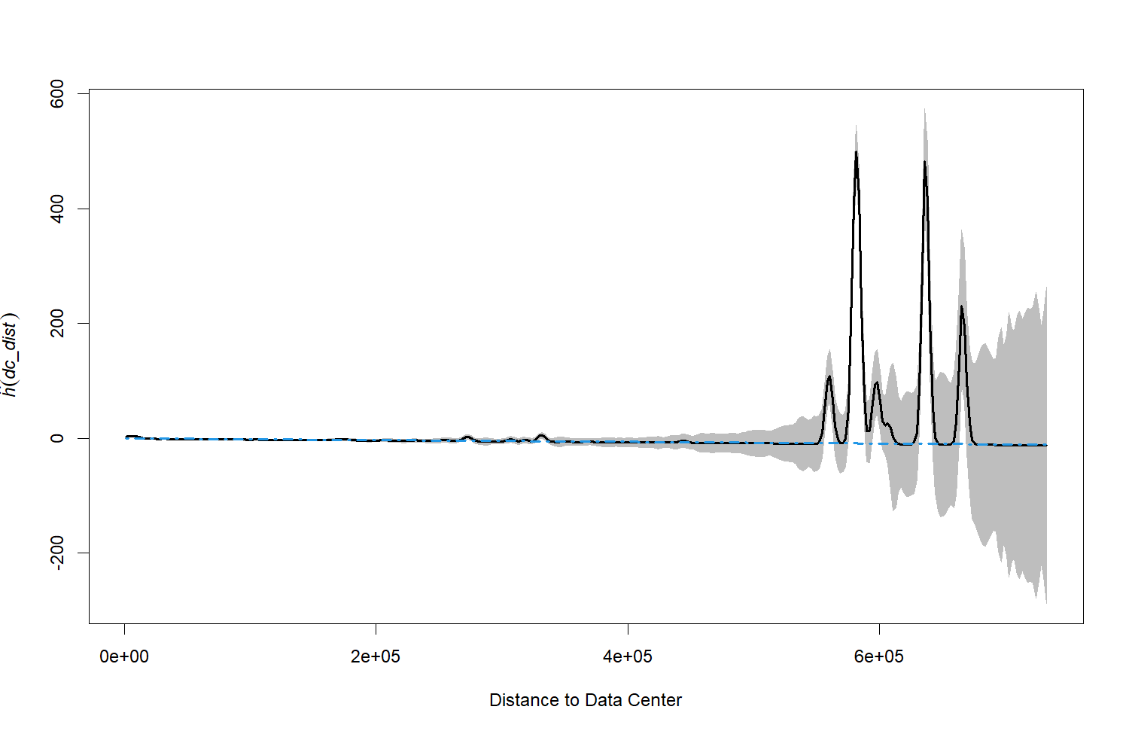
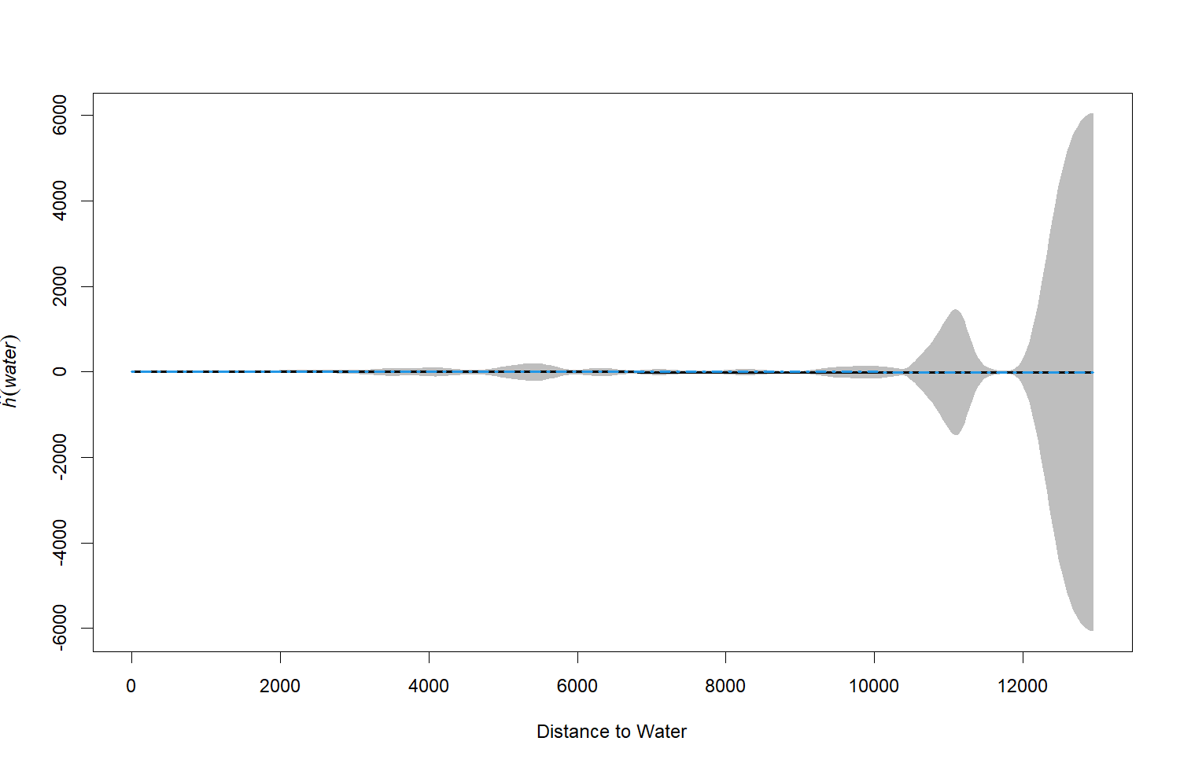
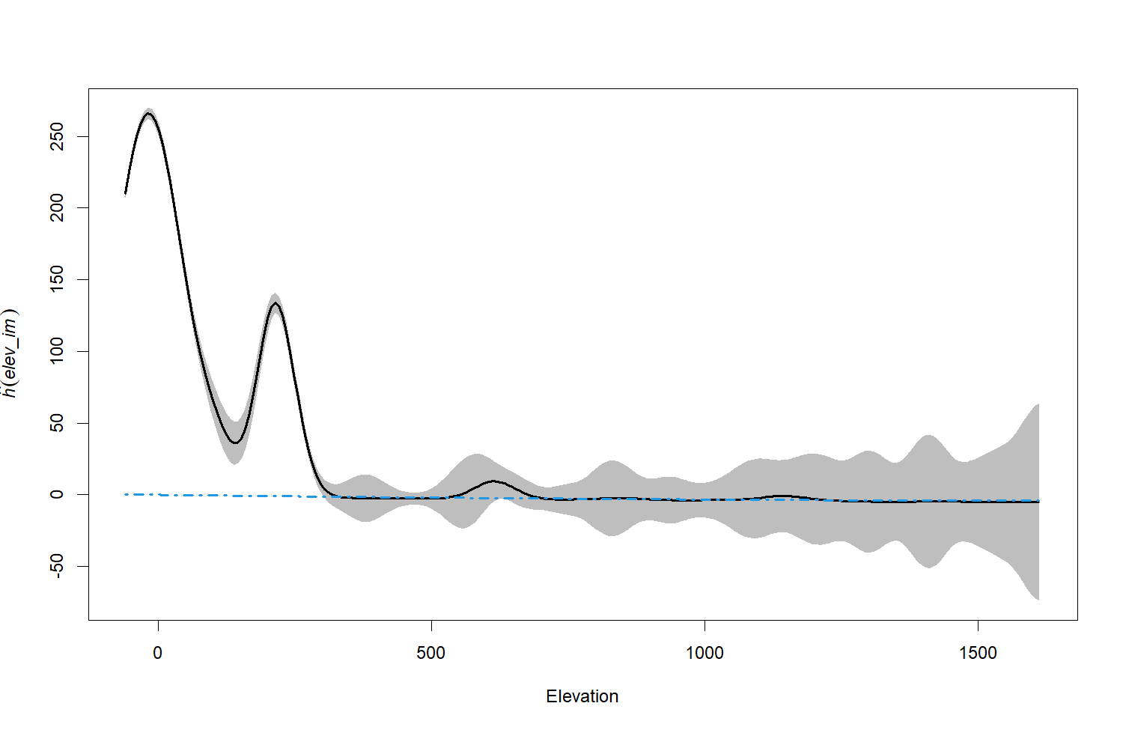
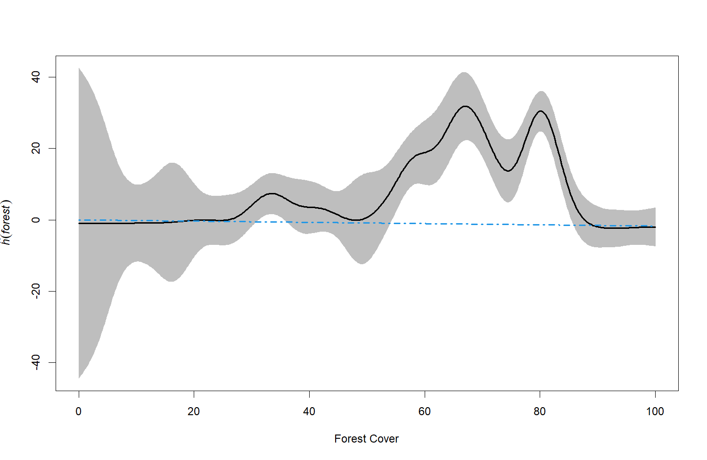
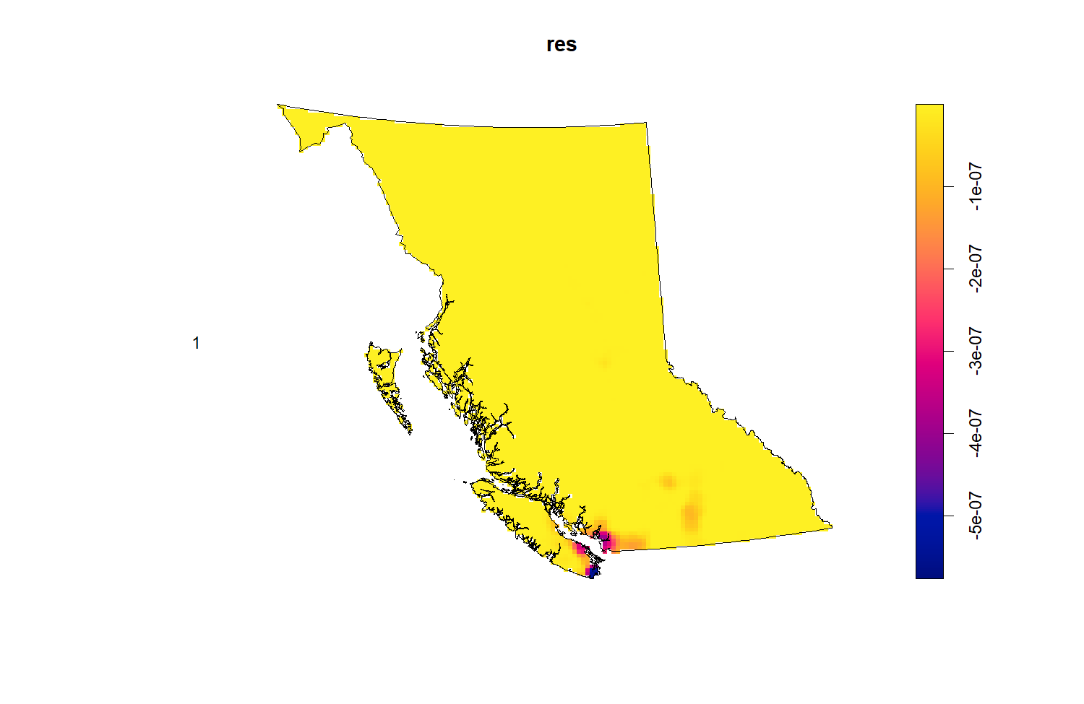
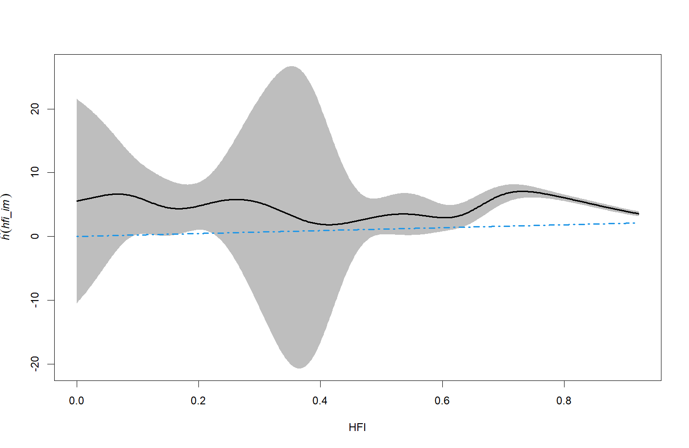
Partial Residual Plots
RESIDUALS:
GOOSE
BC Residual Map

Slide 28
Partial Residual Plots
RESIDUALS:
GOOSE
BC Residual Map

Slide 29
RESULTS:
MODEL OUTPUT
General Results
Positive HFI
Data Centers
Both models can fit the data well, with a tendency to overfit around Vancouver Island
Certain species appear to be more concentrated around areas with higher human activity
Data centers seem to have an impact on spatial distributions, with mixed results in residuals

Slide 30
DISCUSSION: ARE DATA CENTERS
SIGNIFICANT?
Salmon
Goose
Npar | Df | Deviance | Pr(>Chi)
8
7 | -1 | -213.83 | < 2.2e-16
Npar | Df | Deviance | Pr(>Chi)
7
6 | -1 | -1383 | < 2.2e-16
From both ANOVAs, we see that the inclusion of data centers as a covariate is significant in modelling the spatial distributions of our chosen species. That is, data centers do have an impact on how certain animals are distributed within British Columbia.

Slide 31
DISCUSSION:
HUMAN IMPACTS
WHY
is HFI Positive?
WHAT
does this mean for other species?
HOW
can we explore further?
Areas with increased development typically deter predators of our species, which make it a promising habitat for breeding. Many of these areas also provide convenient access to key resources including water and food.
More common species which are threatened by animals up the food chain may thrive in higher HFI locations. However, this may lead to adverse affects including overpopulation.
Model on other species (predators or endangered) to see if they are closer or further away from humans, add covariates to improve the overall fit of the model, and conduct more research on data centers.

Slide 32
DISCUSSION:
HUMAN IMPACTS
WHY
is HFI Positive?
WHAT
does this mean for other species?
HOW
can we explore further?
Areas with increased development typically deter predators of our species, which make it a promising habitat for breeding. Many of these areas also provide convenient access to key resources including water and food.
More common species which are threatened by animals up the food chain may thrive in higher HFI locations. However, this may lead to adverse affects including overpopulation.
Model on other species (predators or endangered) to see if they are closer or further away from humans, add covariates to improve the overall fit of the model, and conduct more research on data centers.

Slide 33
DISCUSSION:
HUMAN IMPACTS
WHY
is HFI Positive?
WHAT
does this mean for other species?
HOW
can we explore further?
Areas with increased development typically deter predators of our species, which make it a promising habitat for breeding. Many of these areas also provide convenient access to key resources including water and food.
More common species which are threatened by animals up the food chain may thrive in higher HFI locations. However, this may lead to adverse affects including overpopulation.
Model on other species (predators or endangered) to see if they are closer or further away from humans, add covariates to improve the overall fit of the model, and conduct more research on data centers.

Slide 34
DISCUSSION:
CAN WE DO BETTER?
Quadrat tests on both models suggest there is room for improving the fit
However, there is a tradeoff between using a more complex model for our species
If we want to understand the individual covariate effects and showcase our findings to stakeholders (like the government), simpler models are more actionable

Slide 35
DISCUSSION:
CAN WE DO BETTER?
Quadrat tests on both models suggest there is room for improving the fit
However, there is a tradeoff between using a more complex model for our species
If we want to understand the individual covariate effects and showcase our findings to stakeholders (like the government), simpler models are more actionable

Slide 36
DISCUSSION:
CAN WE DO BETTER?
Quadrat tests on both models suggest there is room for improving the fit
However, there is a tradeoff between using a more complex model for our species
If we want to understand the individual covariate effects and showcase our findings to stakeholders (like the government), simpler models are more actionable

Slide 37
References
GBIF. (n.d.). Global Biodiversity Information Facility. Retrieved April 22, 2025, from https://www.gbif.org/
Wildlife Conservation Society. (n.d.). 20 years of the Human Footprint – Open source data access. Retrieved April 22, 2025, from https://wcshumanfootprint.org/data-access
Pacific Wild. (n.d.). Pacific Salmon Species Spotlight. Retrieved April 22, 2025, from https://pacificwild.org/pacific-salmon-species-spotlight/
Fisheries and Oceans Canada. (n.d.). Information about Pacific salmon | Pacific Region. Retrieved April 22, 2025, from https://www.pac.dfo-mpo.gc.ca/fm-gp/salmon-saumon/facts-infos-eng.html
Monserrate, S. G. (2022). The Staggering Ecological Impacts of Computation and the Cloud. The MIT Press Reader. Retrieved April 22, 2025, from https://thereader.mitpress.mit.edu/the-staggering-ecological-impacts-of-computation-and-the-cloud/
Baxtel. (n.d.). British Columbia Data Centers & Colocation. Retrieved April 22, 2025, from https://baxtel.com/data-center/british-columbia
Data Center Map. (n.d.). Canada Data Centers. Retrieved April 22, 2025, from https://www.datacentermap.com/canada/

Slide 38

THANK YOU

